Slide 1
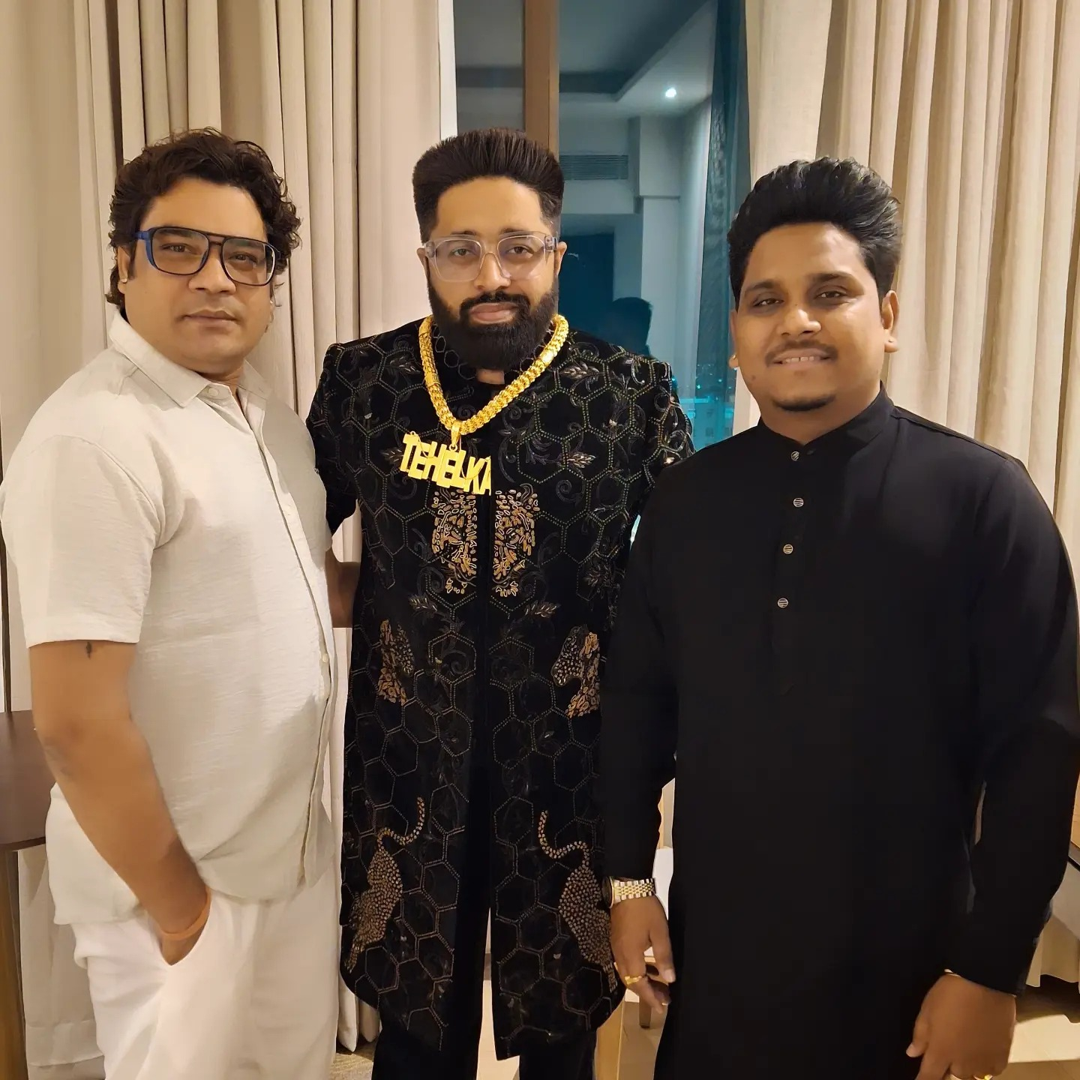
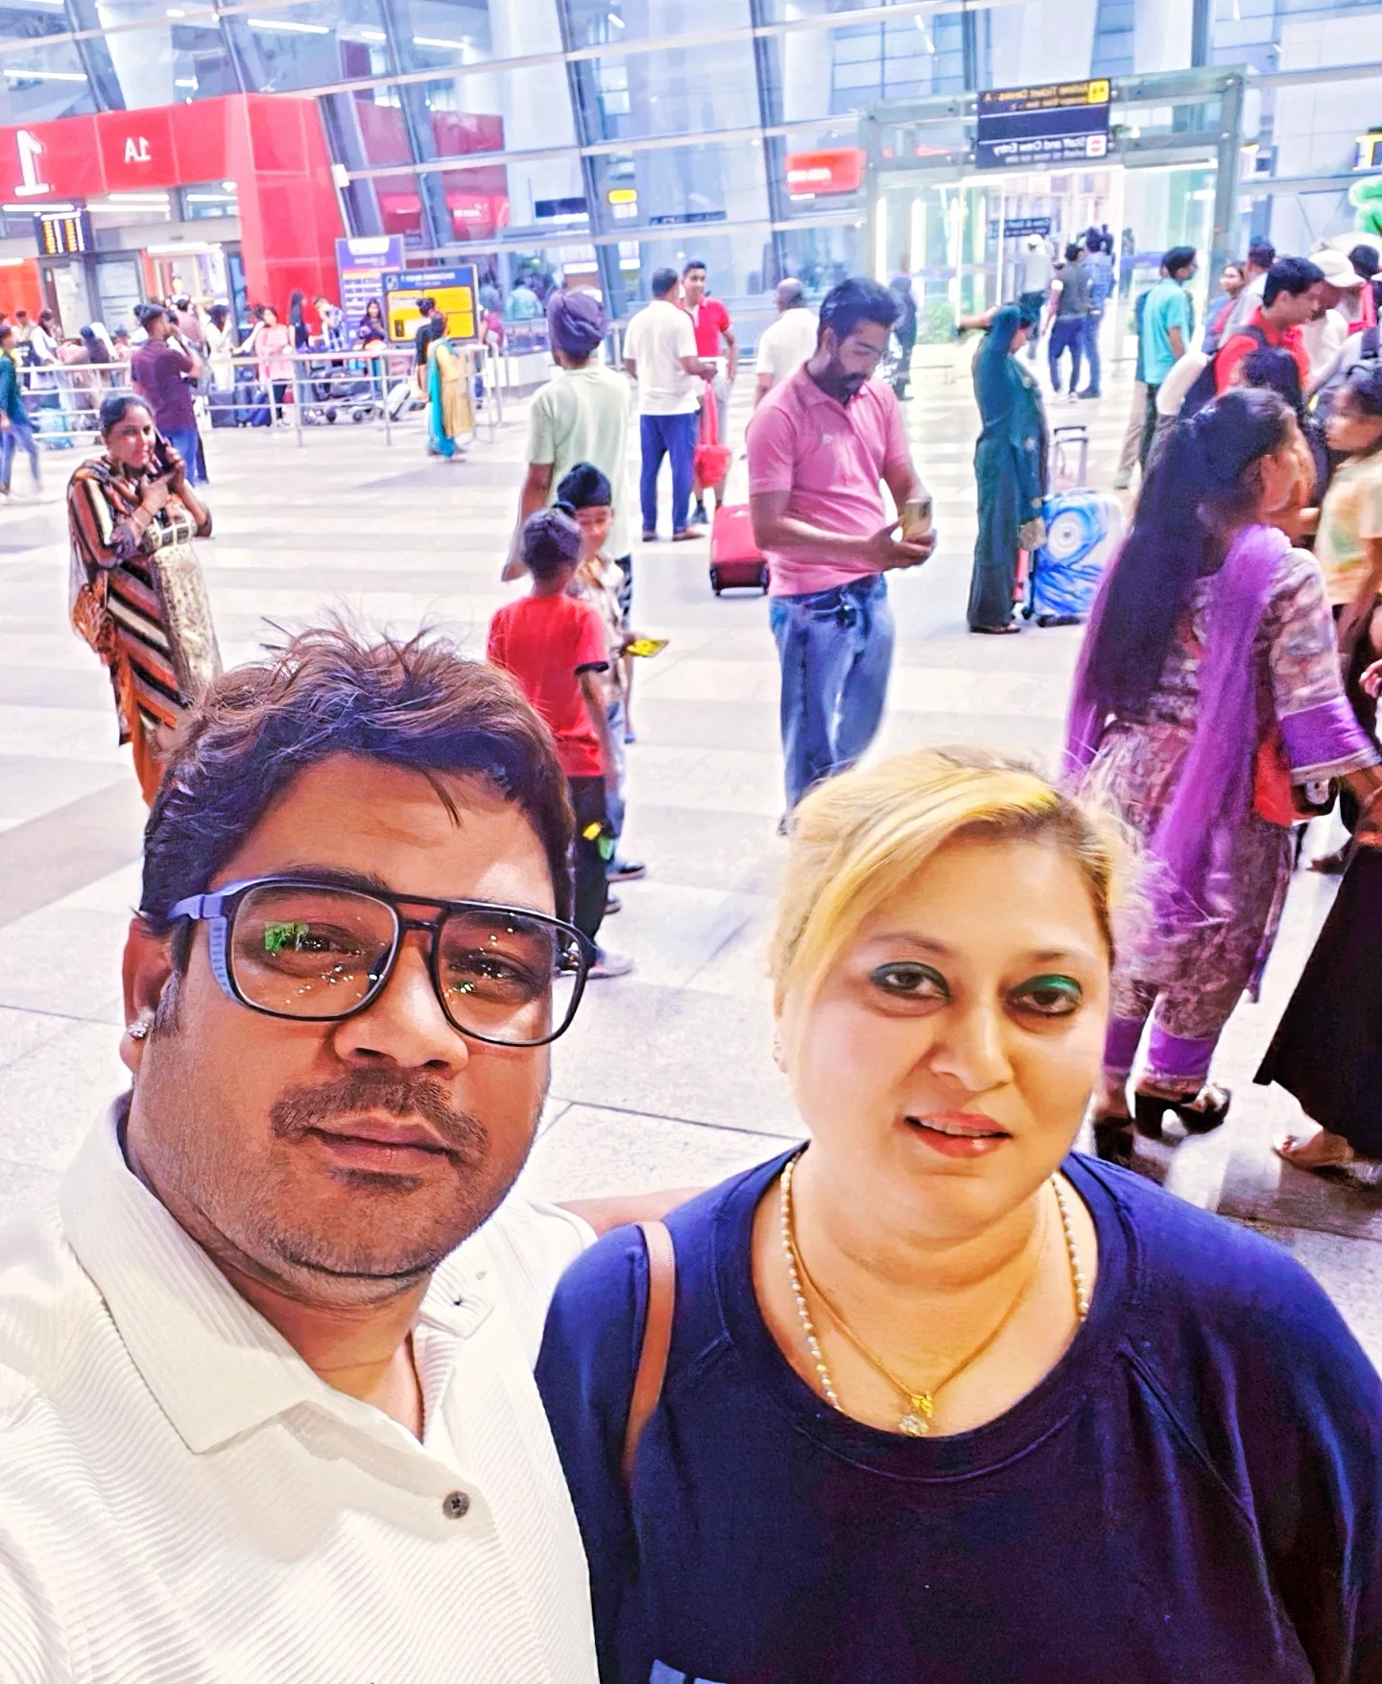
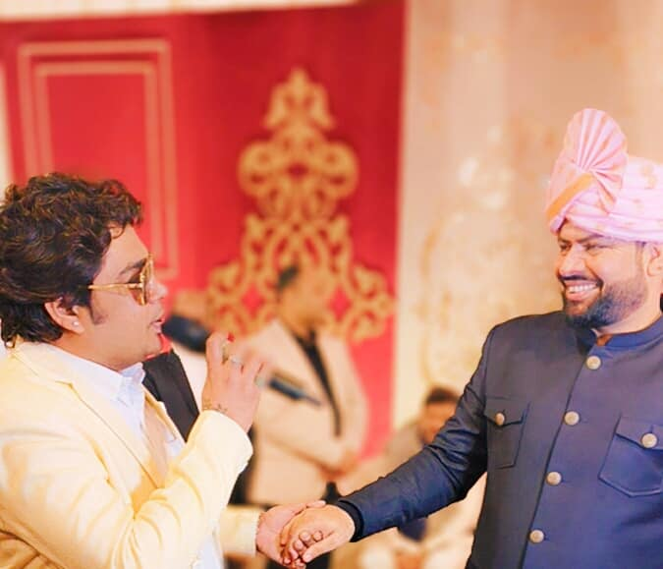



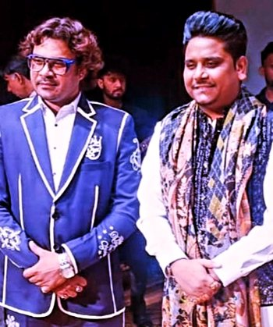




Vishal Srivastav -Playback singer
Vishal Srivastavaa was born 23 September 1983 in Delhi. Vishal Srivastavaa one of the contestant on X Factor India Sony Entertainment Television & Colors TV RISING STAR.T-Series recently launched Vishal Srivastavaa’s new album JOGIRA.
9717618734/09717618734
vishalsrivastavofficial@gmail.com
Liknk
LINK
Link1
Link 2
Link 3
Link 4
Link 5
Link

