Slide 1
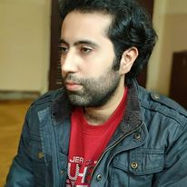
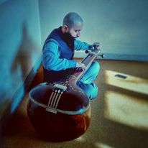




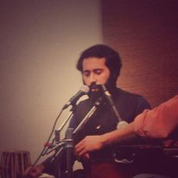




Tanuj Manchanda- Sufi singer
Singing is my passion and my favorite genres in music are Hindustani Classical, Bollywood, Light Music.
9711579798
tanuj0079@gmail.com
Link
Link
Link1
Link 2
Link 3
link 4
Link 5
NA

