Slide 1
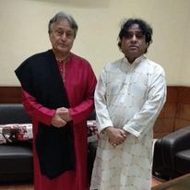
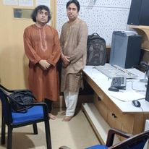
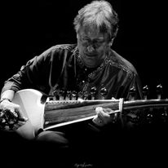



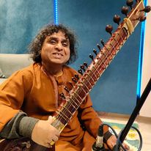
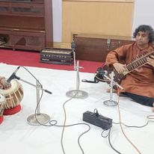
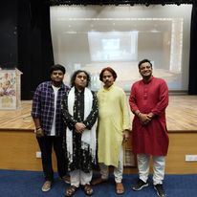



Sunil Kant Saxena- Sitar player
Sitar maestro Sunil Kant Saxena is an Indian Classical Musician.
9811470308/0120-2553589
Sunilkantsaxena@yahoo.co.in
Link
NA
Link1
Link 2
Link 3
link 4
Link 5
NA

