Slide 1
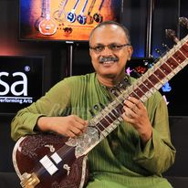
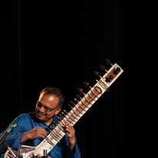
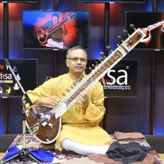



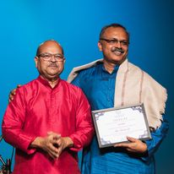
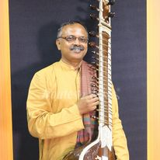



Subrata De- Sitar player
Shri Subrata De is a well-known name in Sitar. He represents Bishnupur Gharana of Hindustani Classical Music. He is an able disciple of Pt. Manilal Nag. Subrata has not only earned his reputation as a performer, but as a cultural ambassador of India, propagating Indian culture in its purest form all over the world.
9818300319
sitarsubrata@gmail.com
Link
Link
Link1
Link 2
Link 3
link 4
Link 5
Link

