Slide 1
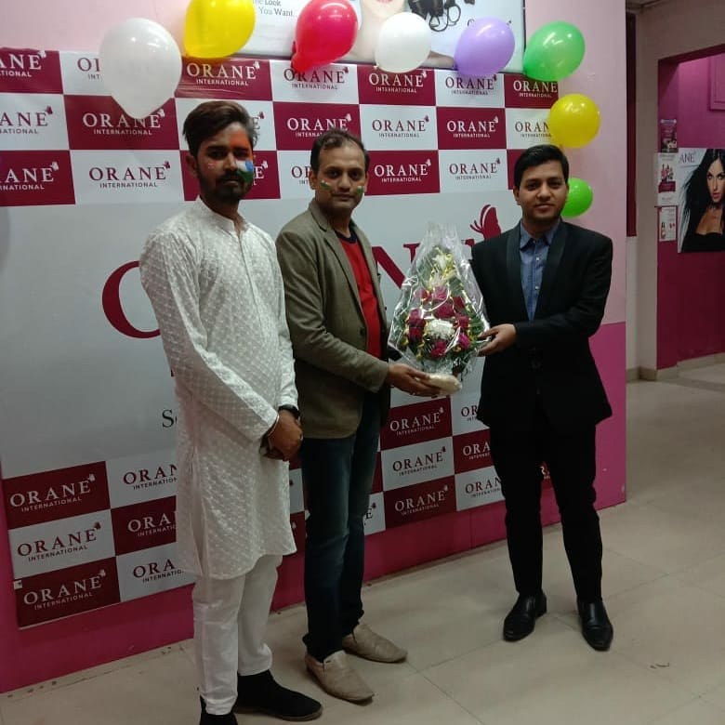
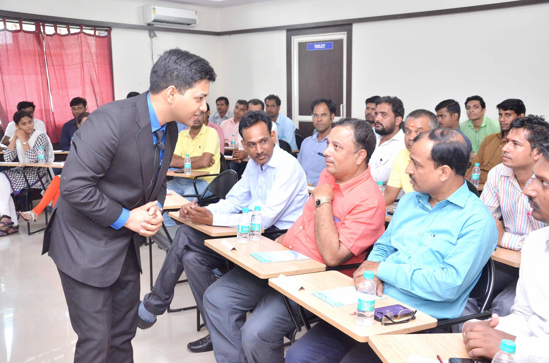
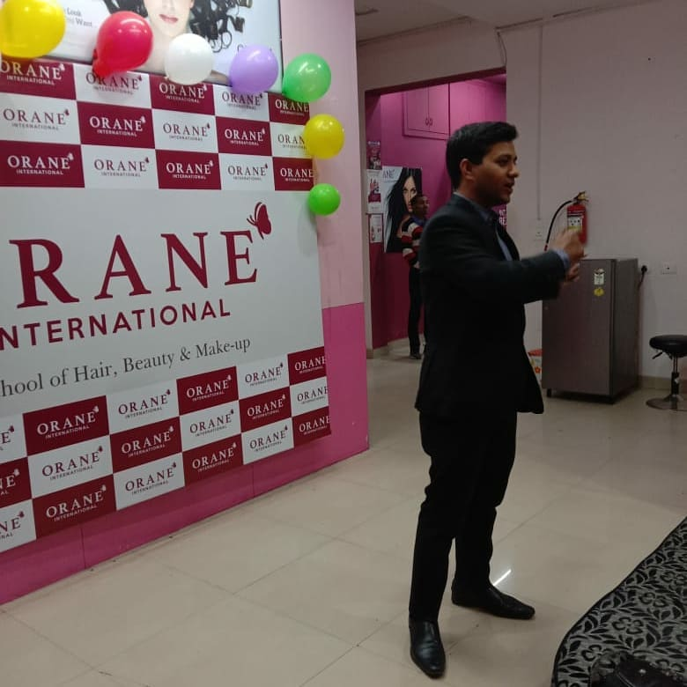



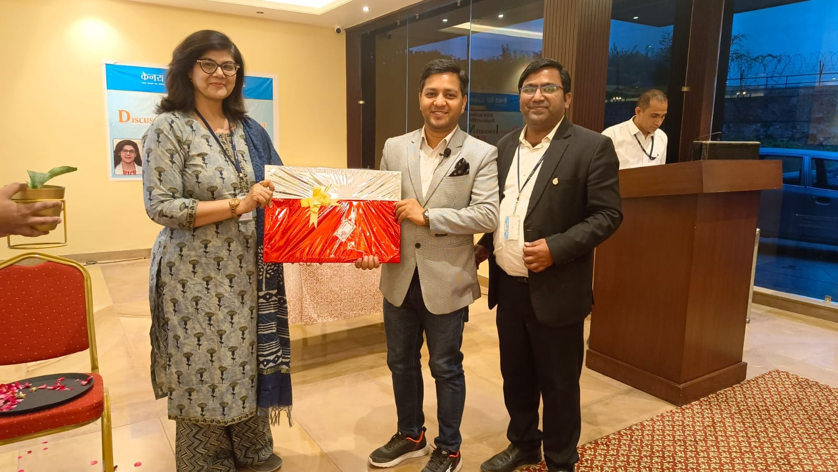
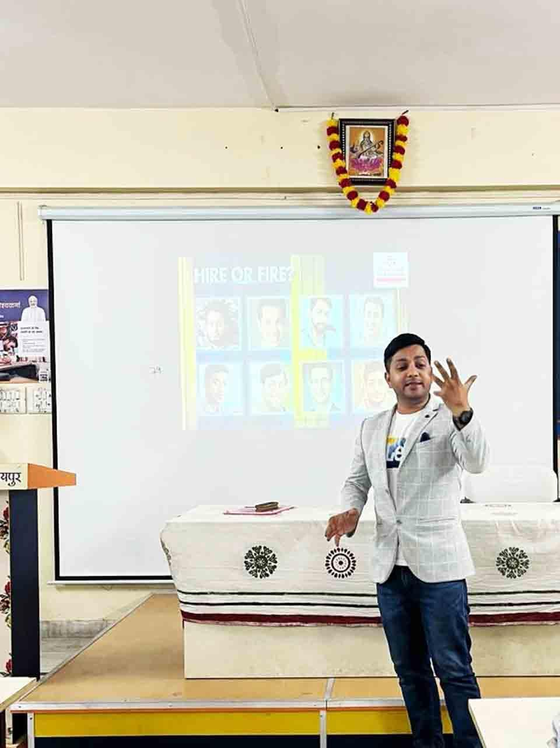



Shikhar Prajapati -Motivational Speaker
Meet an Inspirational Speaker with Passion and Drive Shikhar Prajapati well renowned Motivational Speaker & Corporate Trainer. Offering training in motivational speaking and corporate training,Motivation, Leadership,
9529950482/9351385042
training@shikharprajapati.com
Link
LINK
Link 4
Link 3
Link 5
Link 2
Link1
Link

