Slide 1
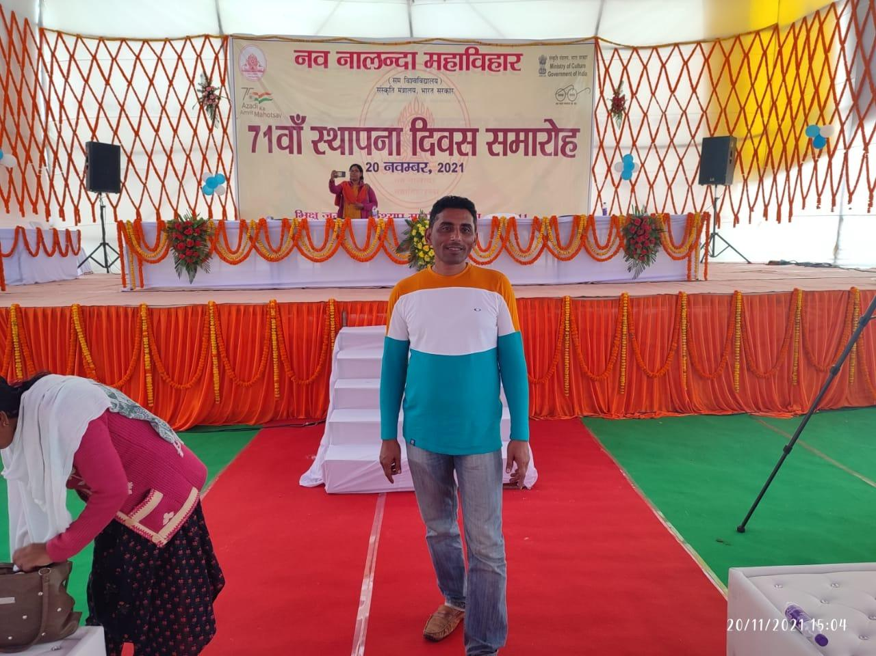
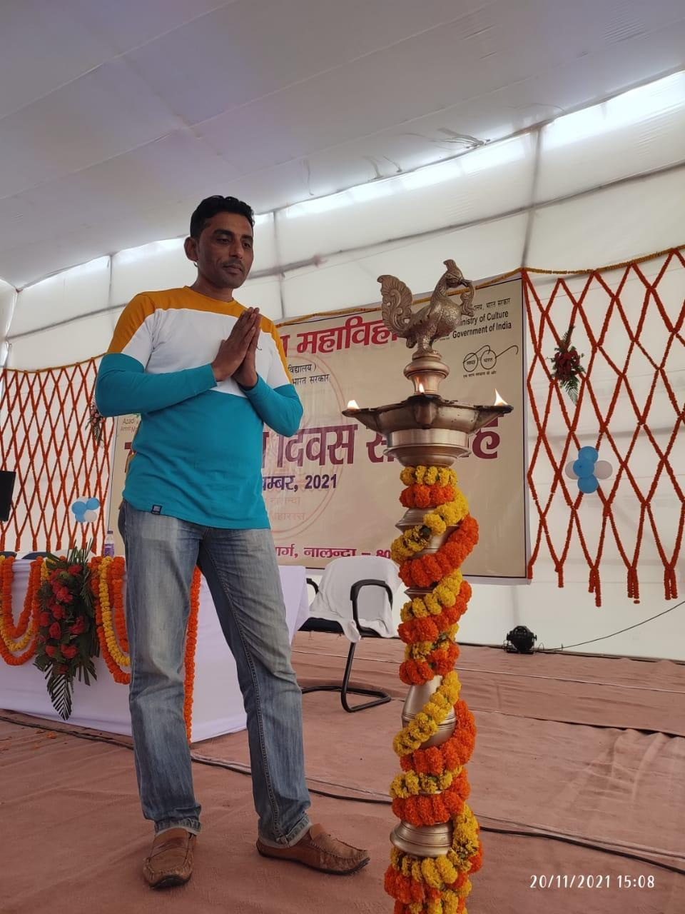
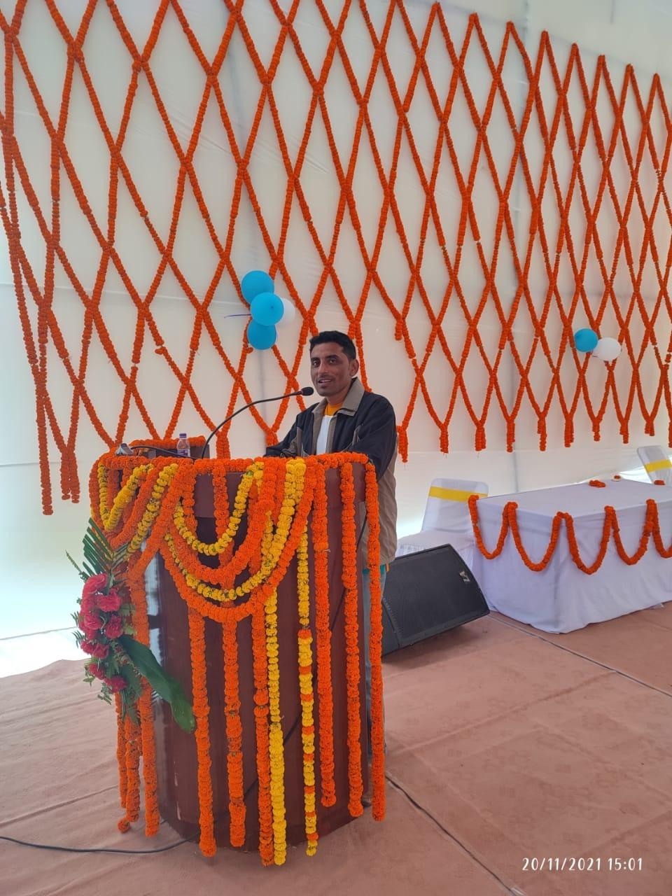




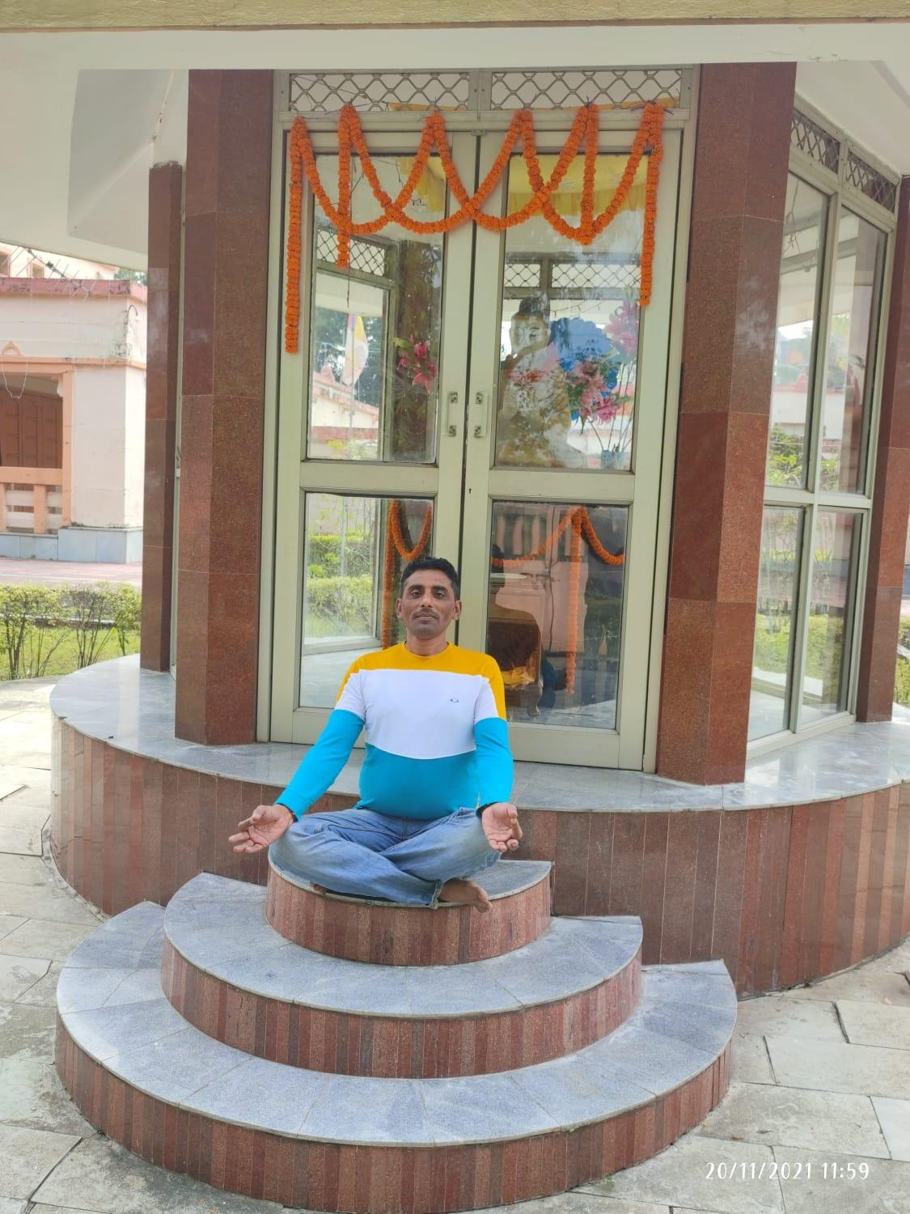


Shardakant Shandilya -Motivational Speaker
An Online Marketing Consultant , Corporate Yoga Trainer, Anchor and Motivational Speaker
9619713801
soum.cdindia@gmail.com
Link
LINK
Link 4
Link 3
Link 5
Link 2
Link1
NA

