Slide 1
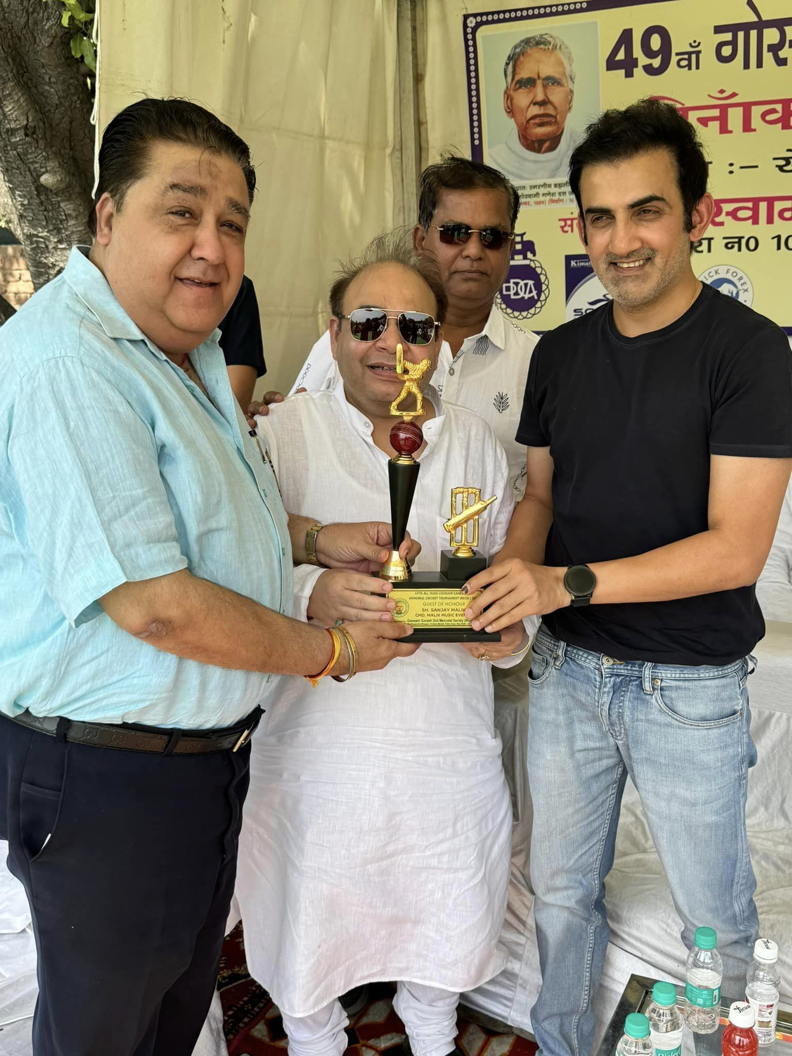
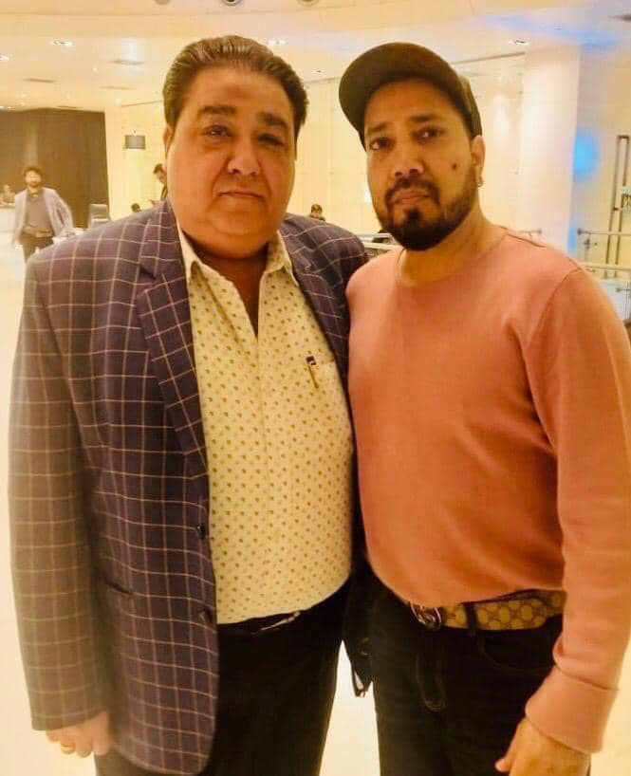
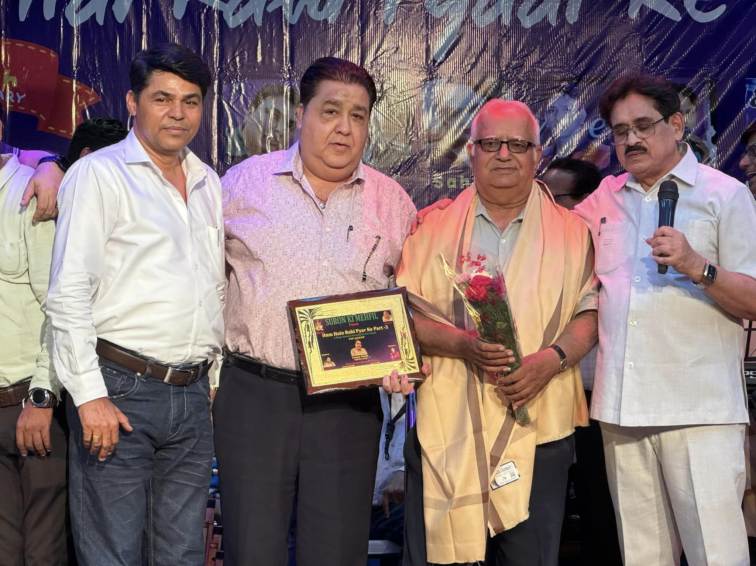


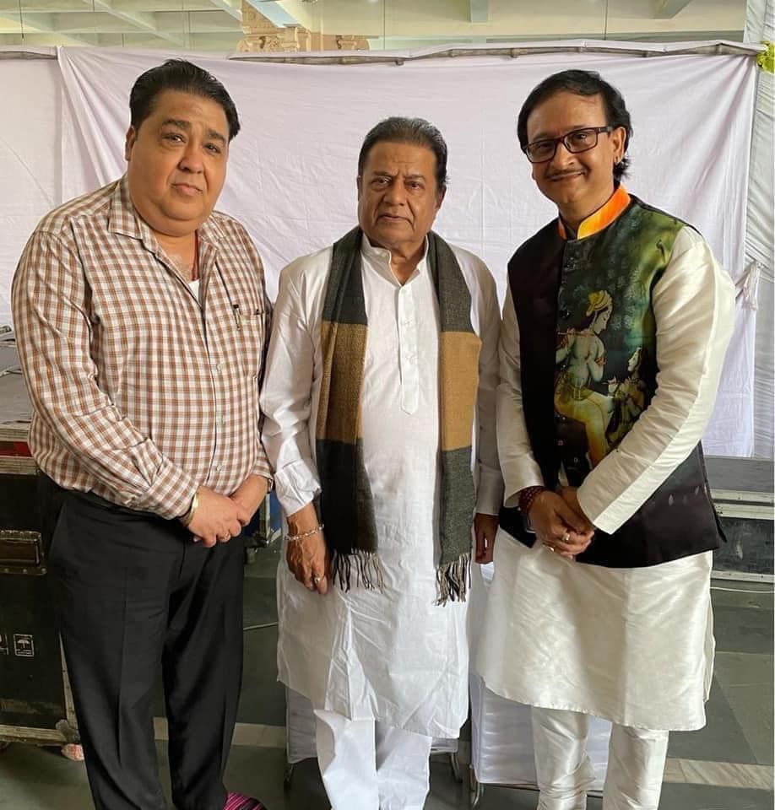

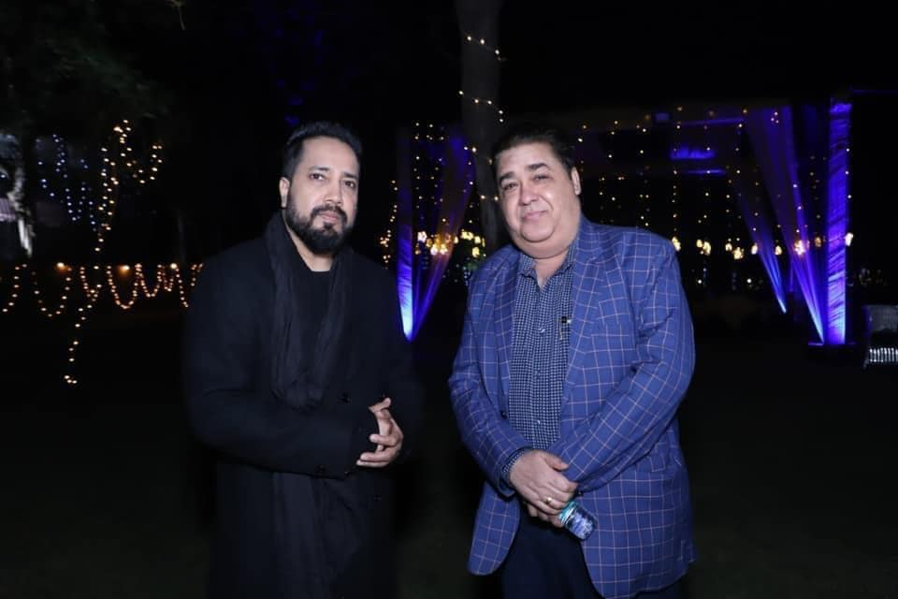



Sanjay Malik -Playback singer
At Malik Music Event Company, we are passionate about creating unforgettable musical experiences that resonate with our clients and their audiences
9810016219/9873316219
malikmusicentertainer@gmail.com
Link
LINK
Link1
Link 2
Link 3
Link 4
Link 5
Link

