Slide 1
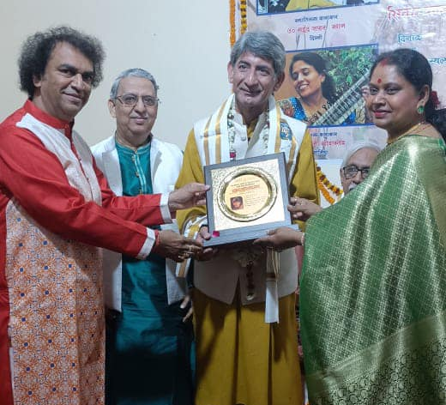
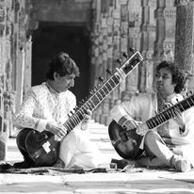


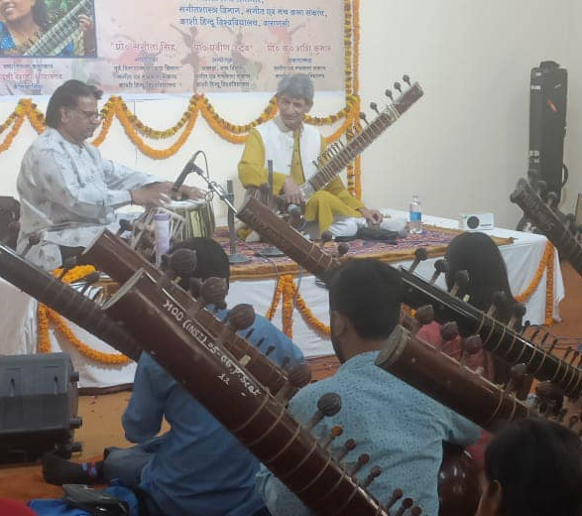

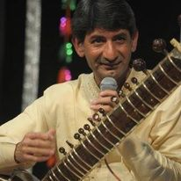



Saeed Zafar Khan- Sitar player
Saeed Zafar Khan was born in a home where his cradle was literally surrounded by stalwarts of the Delhi gharana like the Ustad Chand Khan,
9811910566
saeedzafar@yahoo.com
Link
NA
Link1
Link 2
Link 3
link 4
Link 5
Link

