Slide 1
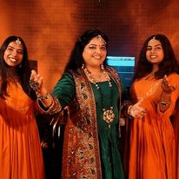










Roohani Sisters- Sufi singer
The Roohani Sisters (Jagriti Luthra Prasanna and Neeta Pandey Negi) are synonymous with Sufi music. They have performed Sufiyana kalams, qawwali, Kafi and ghazals, merging their music with various elements of Indian classical music such as sargams, tans, bol-aalap, layakari and bol bant.
9990255295
NA
Link
Link
Link1
Link 2
Link 3
link 4
Link 5
Link

