Slide 1








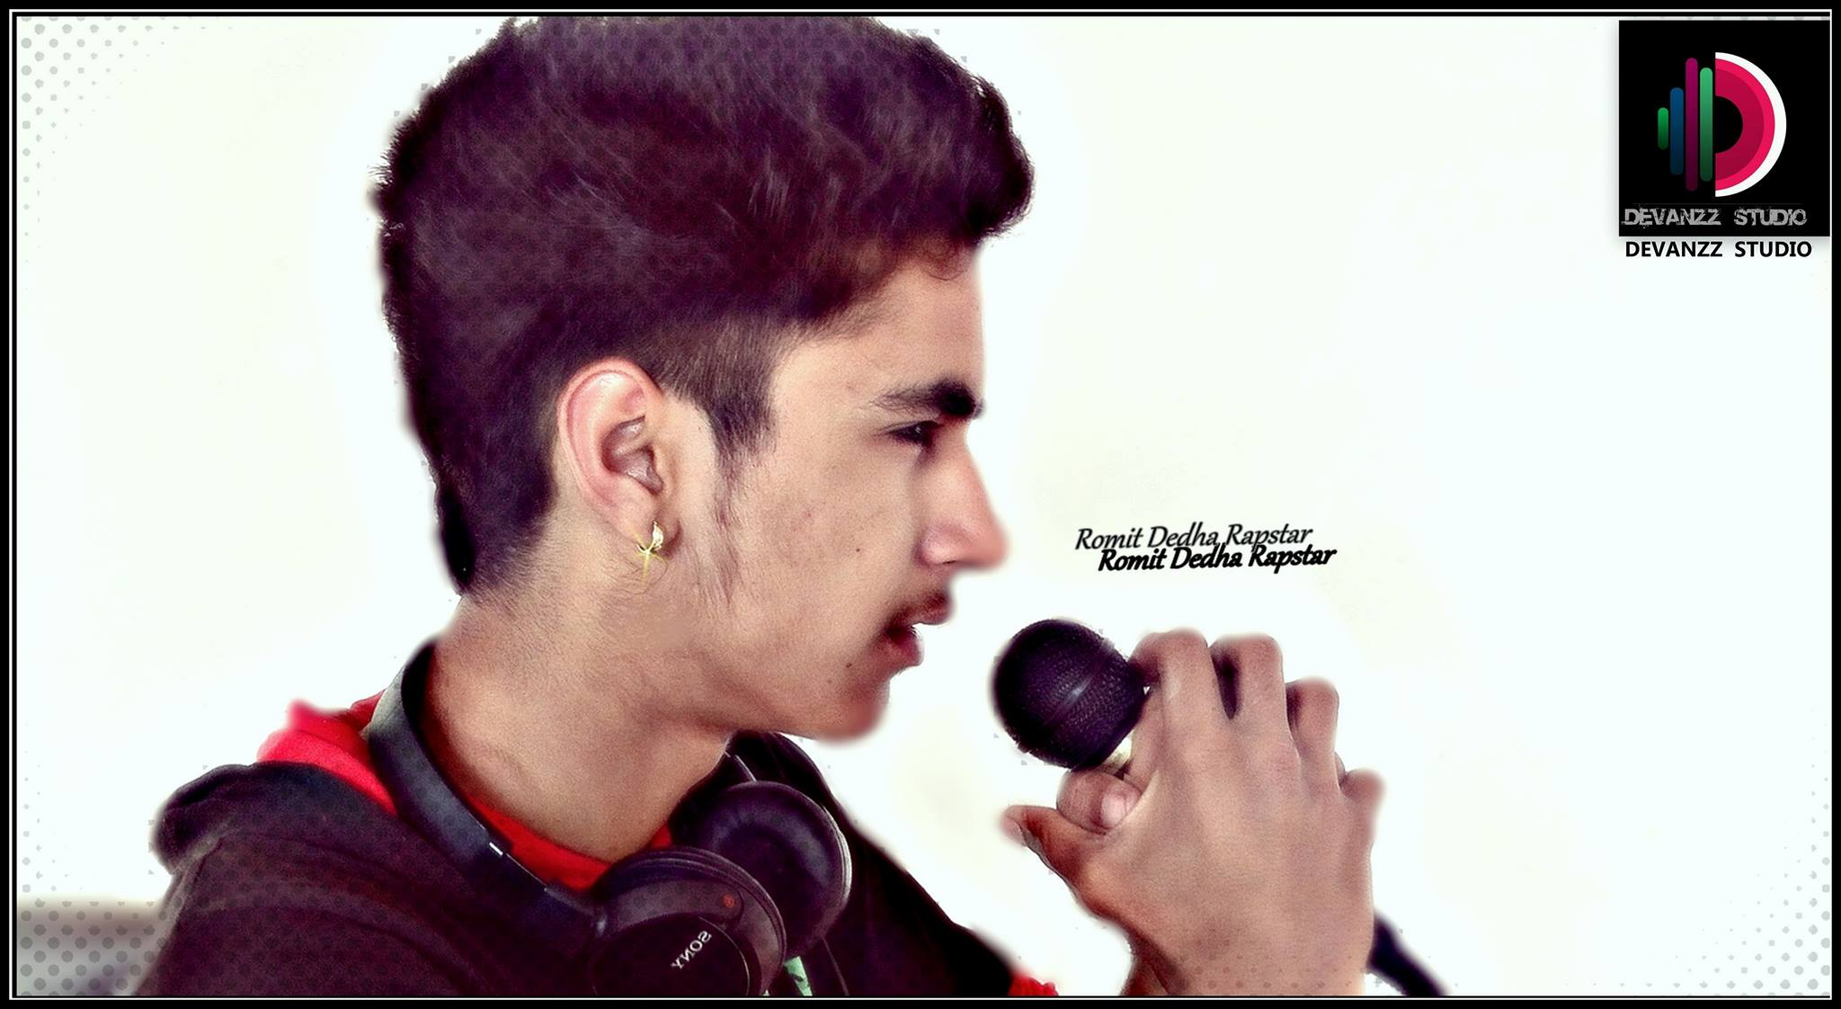


Romit Dedha-Rapper
Romit dedha-rapper, New Delhi, India. 4,180 likes. 9643062798 to the Official page Of "Rd Dedha Rapstar
9643062798
NA
Link
NA
link 4
Link 3
Link 5
Link 2
Link1
NA

