Slide 1
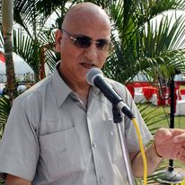
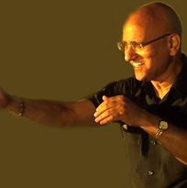

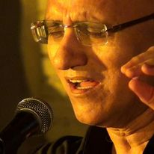


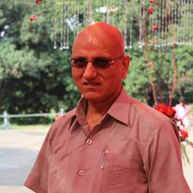



Rajinder Kachroo- Sufi singer
Rajinder Kachroo is a well-trained classical singer, who has experimented with the different forms of music, light classical, folk and devotional music.
9350261601/011-28042910
info@rajinderkachroo.com
Link
NA
Link1
Link 2
Link 3
link 4
Link 5
NA

