Slide 1
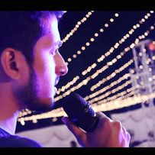





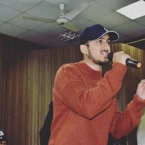

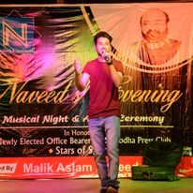



Raja - Rapper
Raja is the indian Rapper singer.
9711710579
Martialartsindia7@gmail.com
Link
NA
Link1
Link 2
Link 3
link 4
Link 5
NA

