Slide 1


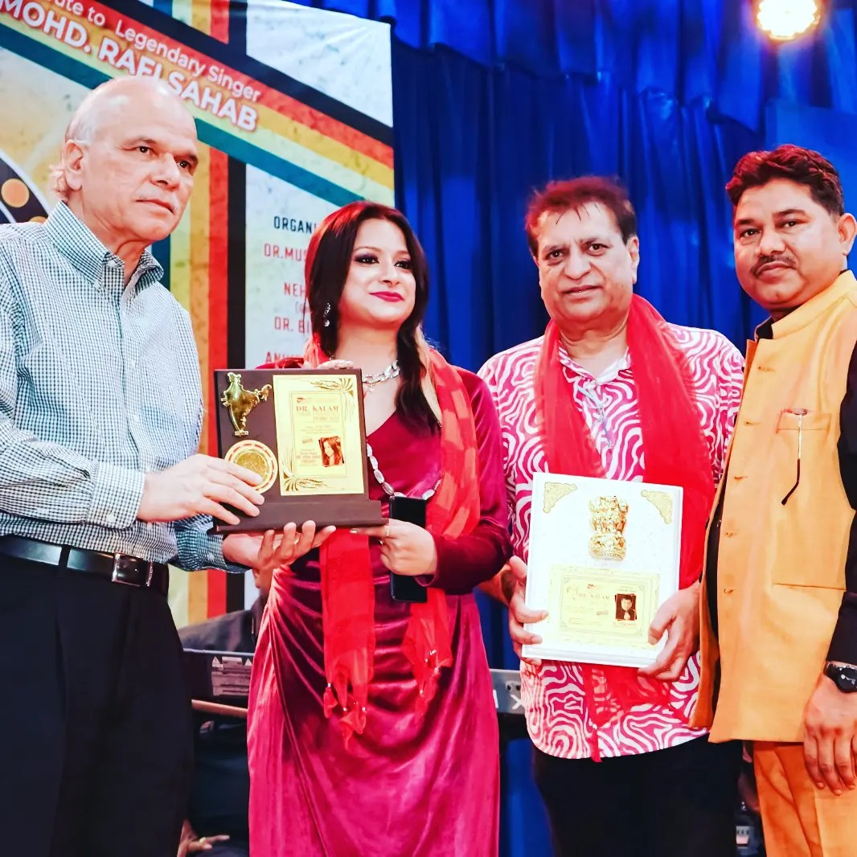

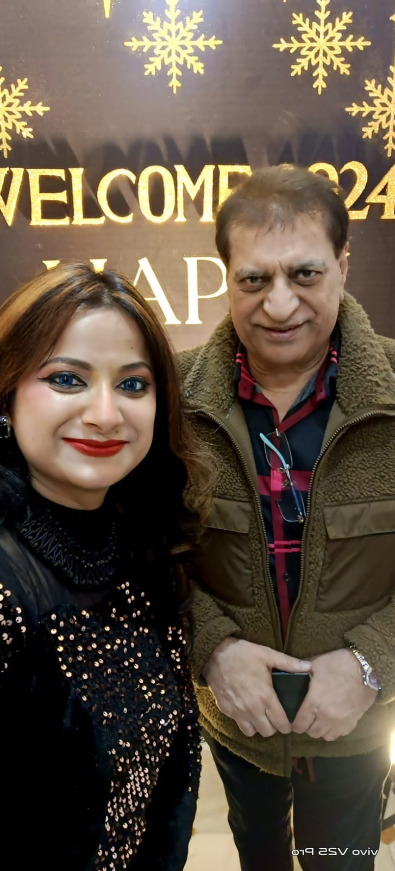






Prem Bhatia -Playback singer
Mr. Prem Bhatia, He is the most highlighted personality in India and Abroad also, everybody knows that he is well performer in
9810033445
prembhatia_singer@yahoo.com
Link
LINK
Link1
Link 2
Link 3
Link 4
Link 5
Link

