Slide 1
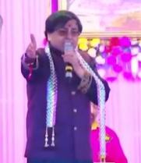
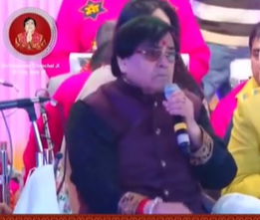
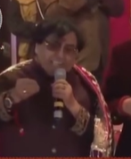

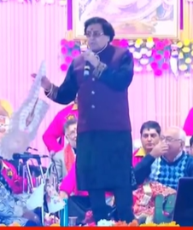


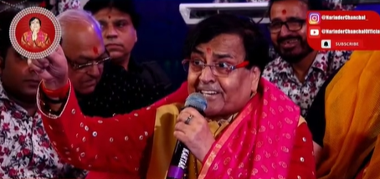



Narendra Chanchal -Playback singer
Narendra Chanchal was an Indian singer who specialized in religious songs and hymns. Besides several bhajans, Chanchal had also sung songs in Hindi films as well. He was the singer of many iconic bhajans & Hindi film songs in history.
9810191914/11-28728708
NA
NA
Link
Link1
Link 2
Link 3
Link 4
Link 5
NA

