Slide 1


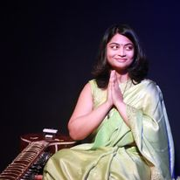



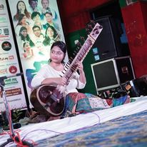
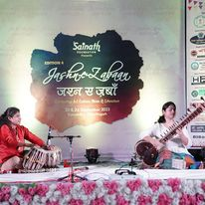



Megha Rawoot - Sitar Player
Megha Rawoot, a resplendent Sitar player based in Mumbai, is a disciple of Sitar maestro Purbayan Chatterjee.
9971482599
mrawoot71@gmail.com
Link
Link
Link1
Link 2
Link 3
link 4
Link 5
Link

