Slide 1
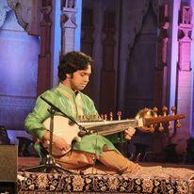
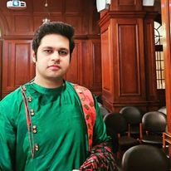
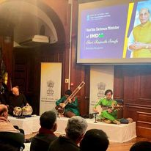
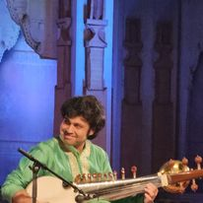



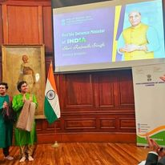

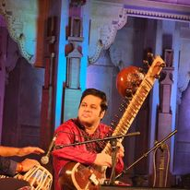



Lakshay Mohan - Sitar Player
"The young Lakshay Mohan playing sitar and sarod, hailing from the Maihar Gharana are well-known amongst the art connoisseurs. music fraternity and audience." -
9810059112
akshayaayush@gmail.com
Link
Link
Link1
Link 2
Link 3
link 4
Link 5
Link

