Slide 1
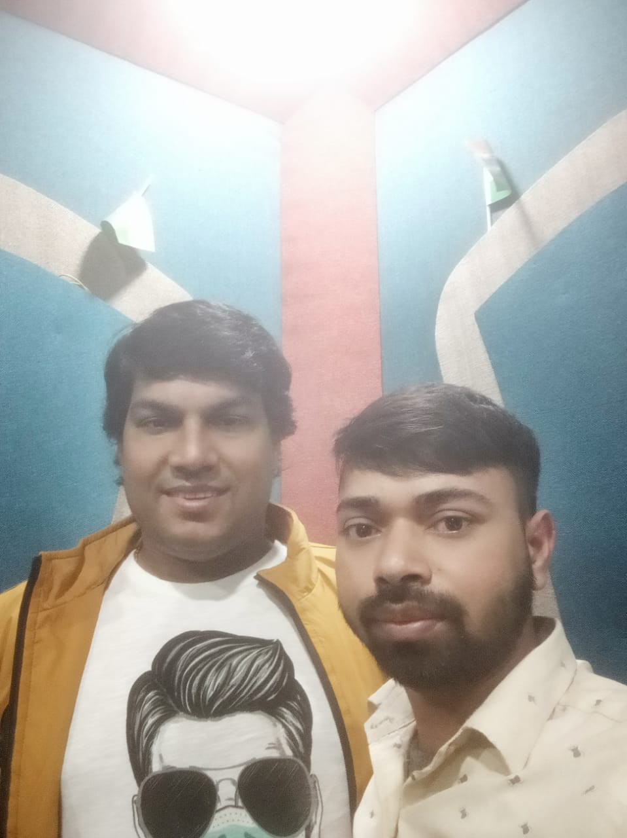










Kuldeep Sharma -Playback singer
Kuldeep Sharma, popularly known as Nati King, is a famous singer from Himachal. Kuldeep Sharma is known for performing “Nati”, the traditional folk dance of Himachal Pradesh
9810250039/11-22946720
Kuldeepsharma99@icloud.com
Link
LINK
Link1
Link 2
Link 3
Link 4
Link 5
NA

