Slide 1


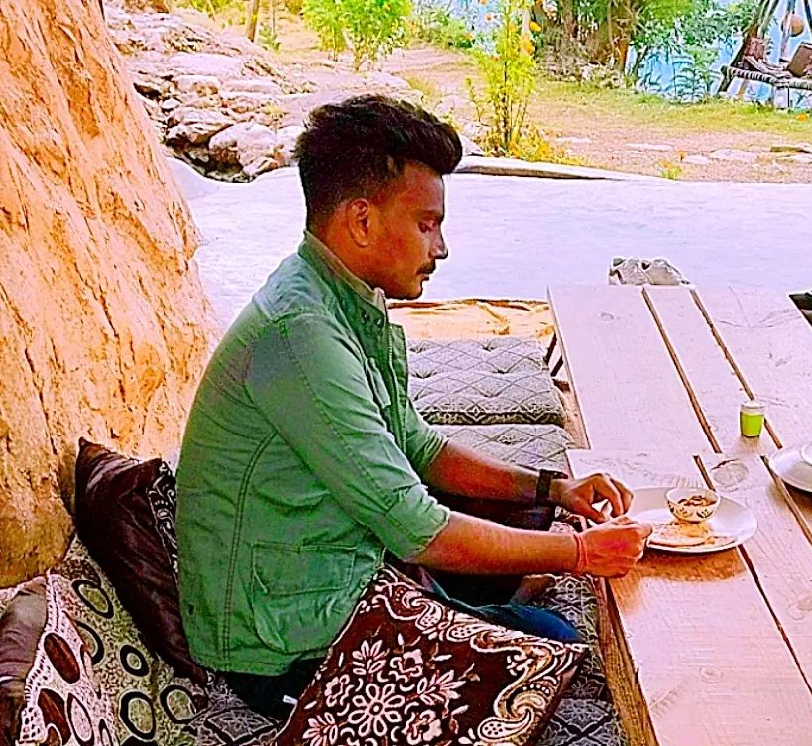



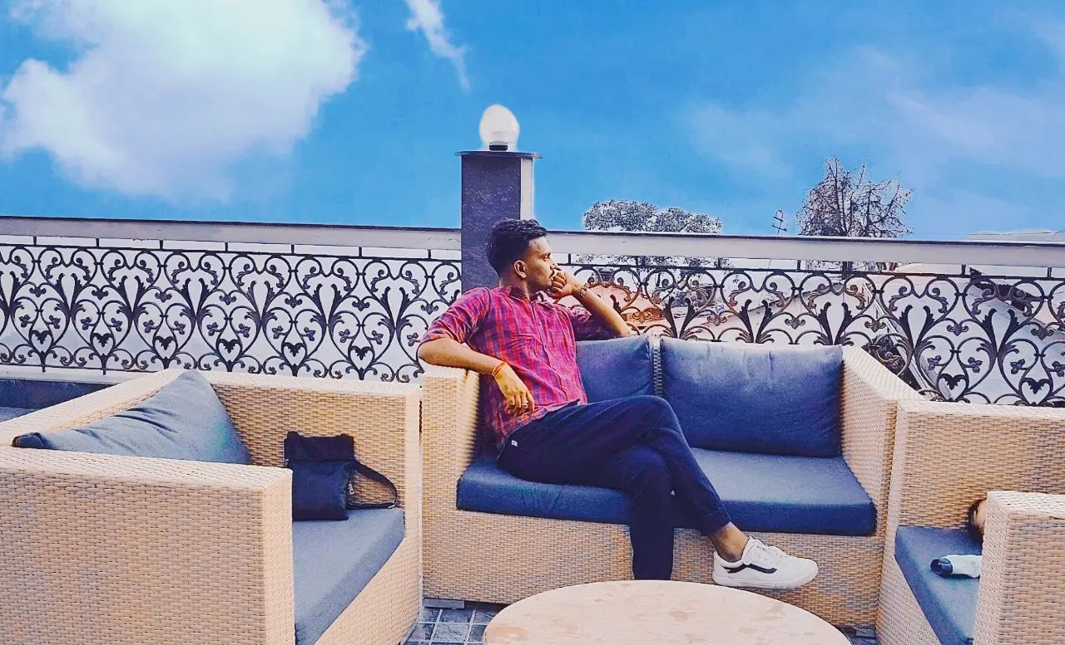
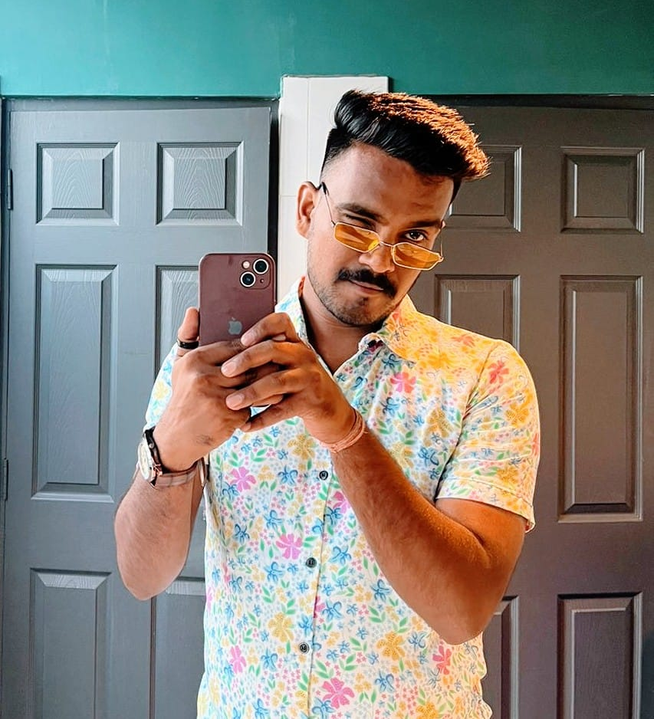



Kapil Dinkar - Musician
Kapil Dinkar channel for all the best and latest official music videos, behind the scenes and live performances
9210336308
kapilmusic6@gmail.com
Link
LINK
link 4
Link 3
Link 5
Link 2
Linkk1
NA

