Slide 1
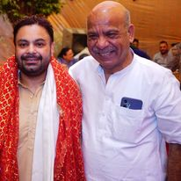

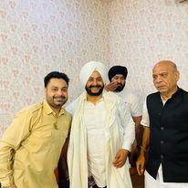




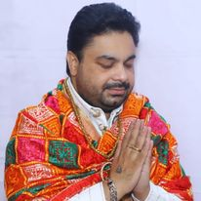



Jonny Sufi- Sufi singer
Jonny Sufi is a renowned singer based in Delhi who is known for his vibrant and full of energy live shows and stage performances. Supremely .
9818440472/9899951850
jonnysufi10@gmail.com
Link
NA
Link1
Link 2
Link 3
link 4
Link 5
NA

