Slide 1






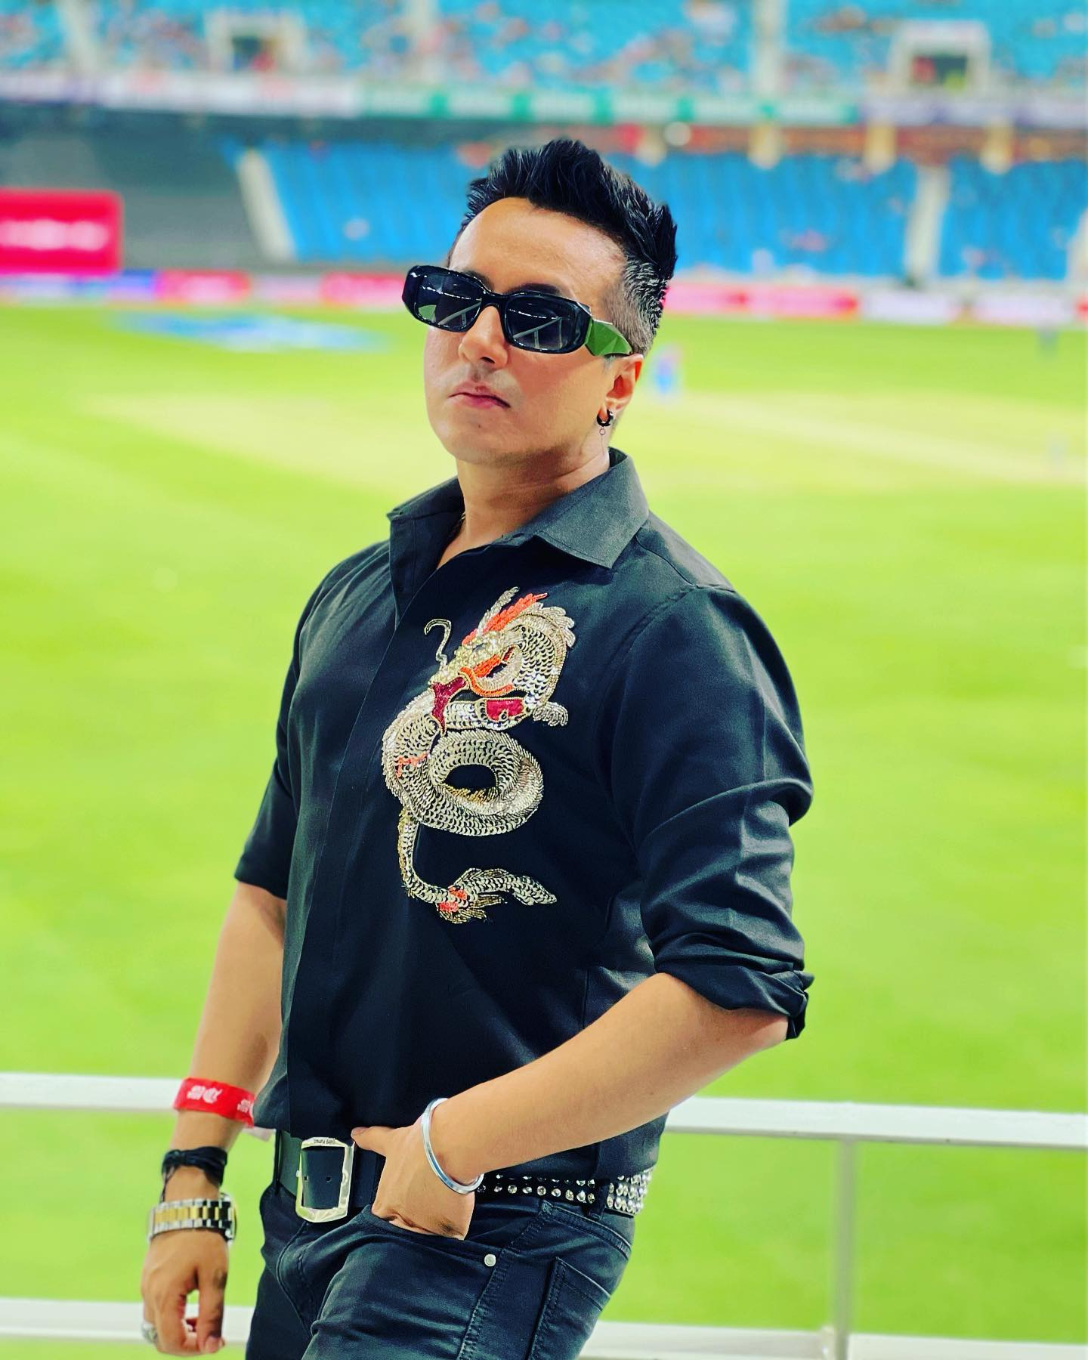
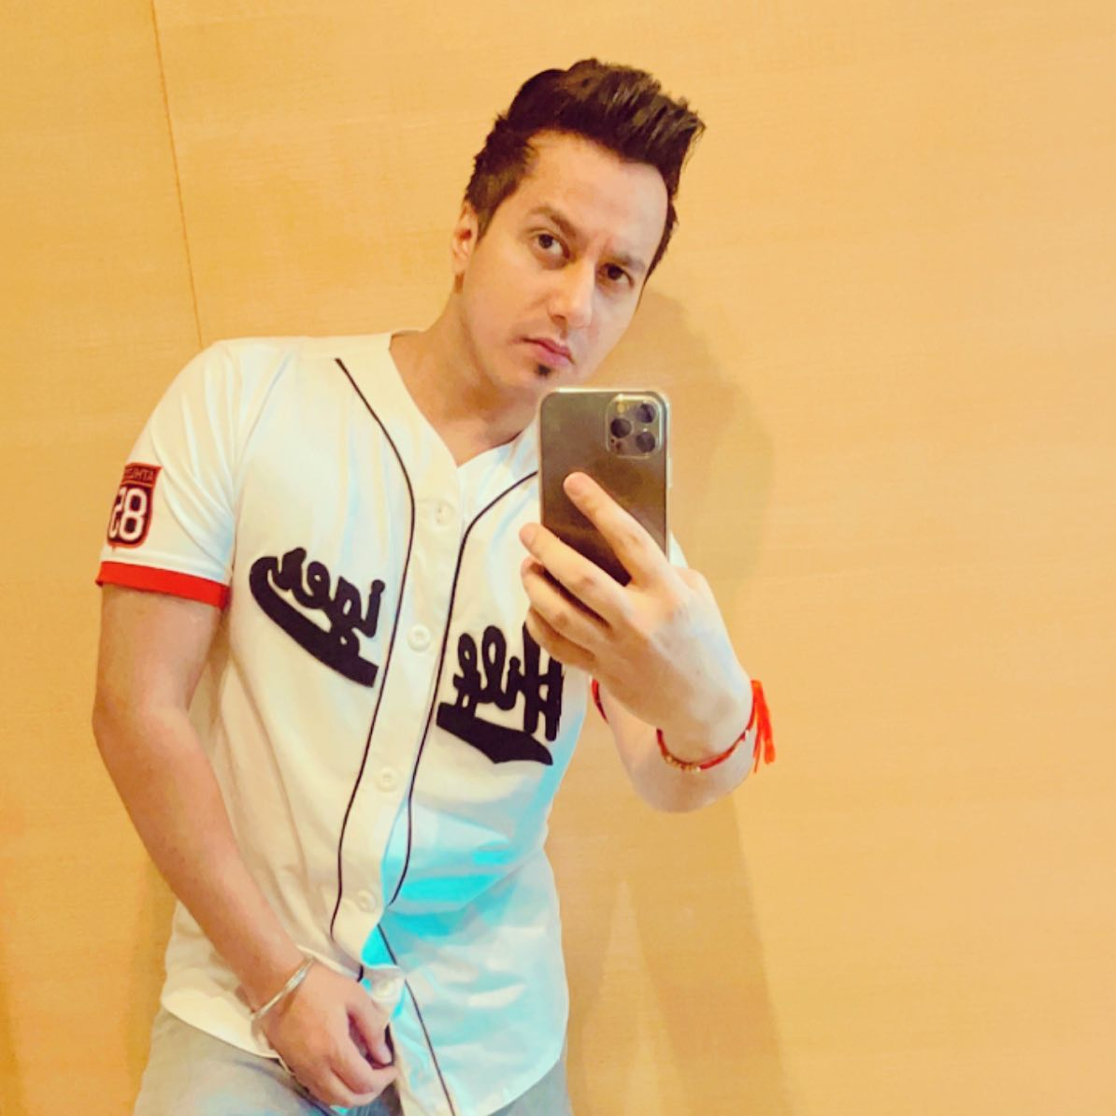



Harshit Tomar- Rapper
Harshit Tomar is a talented Indian singer, rapper, and songwriter known for his contributions to the Indian music industry
9999446262/9953294022
harshitsuperstud@yahoo.com
Link
Link
link 4
Link 3
Link 5
Link 2
Link1
NA

