Slide 1
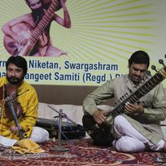
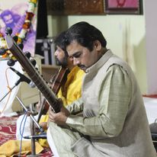
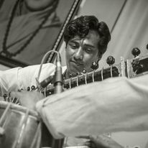



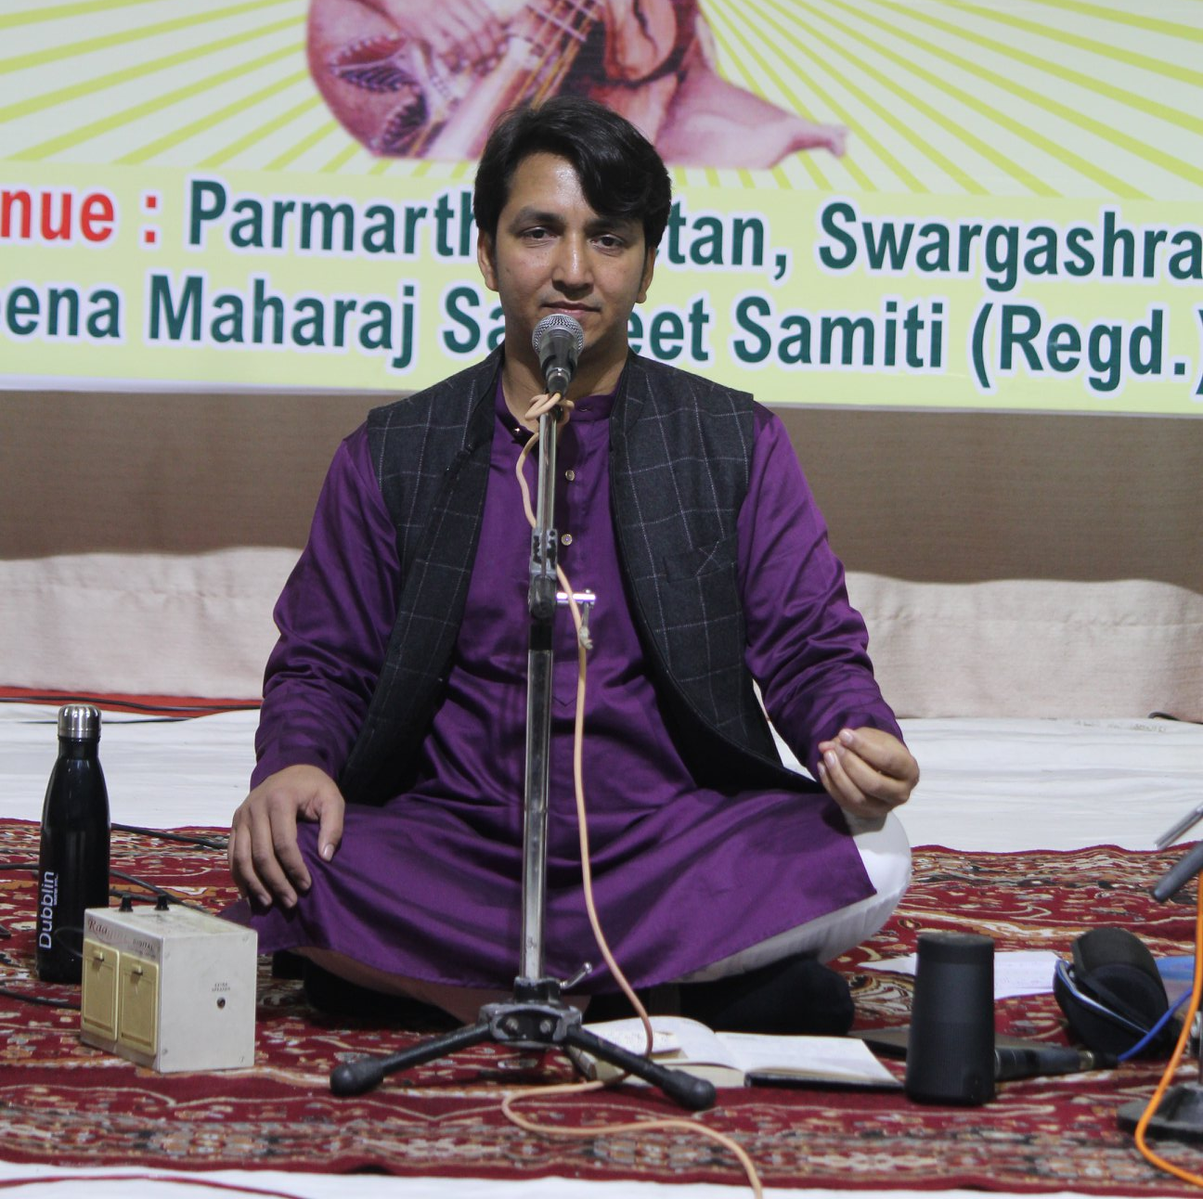
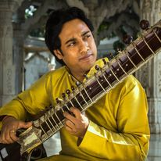



Gopal Krishan Shah- Sitar player
Born in a family rooted to musical background, Gopal Krishan Shah learnt music under his father Pt. Hari Krishan Shah, a disciple of Swami D. R Parvatikar Ji ...
9899697373/8750165258
gopalkrishanshah@gmail.com
Link
NA
Link1
Link 2
Link 3
link 4
Link 5
NA

