Slide 1
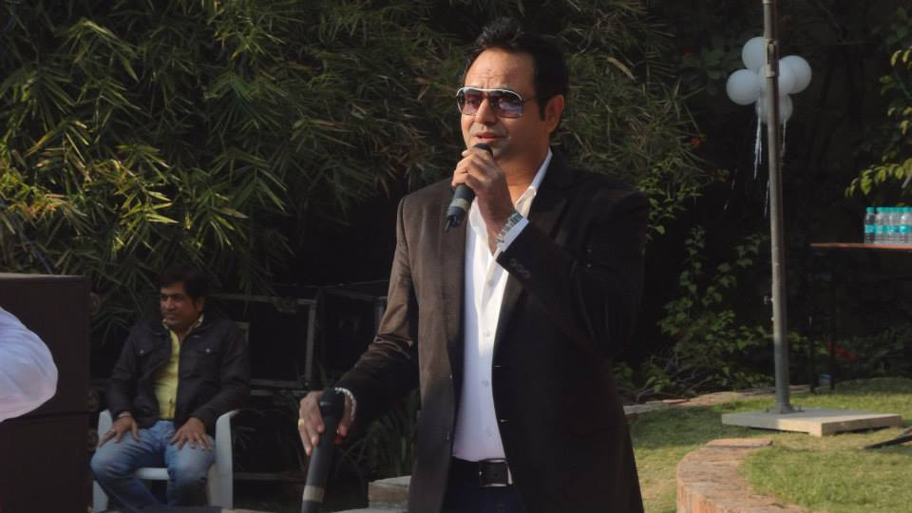
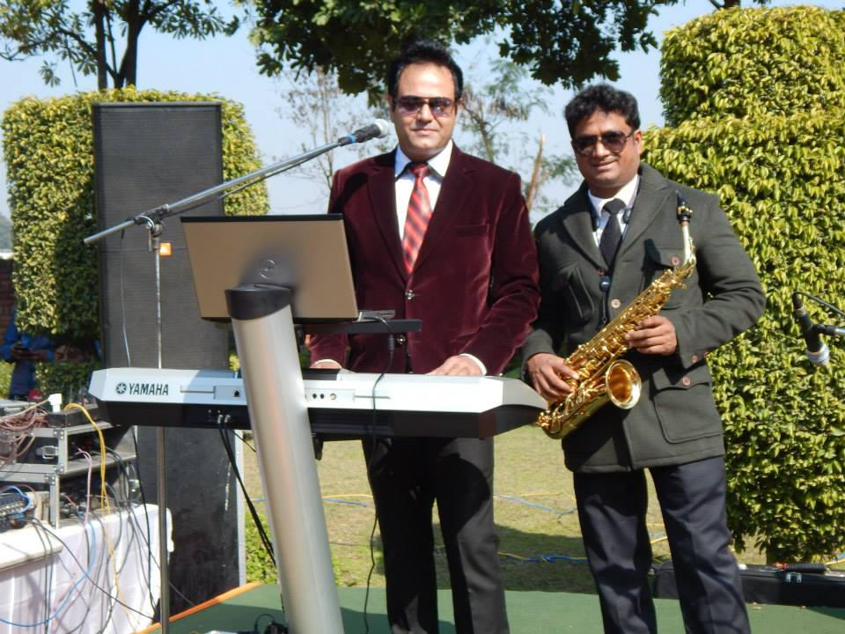
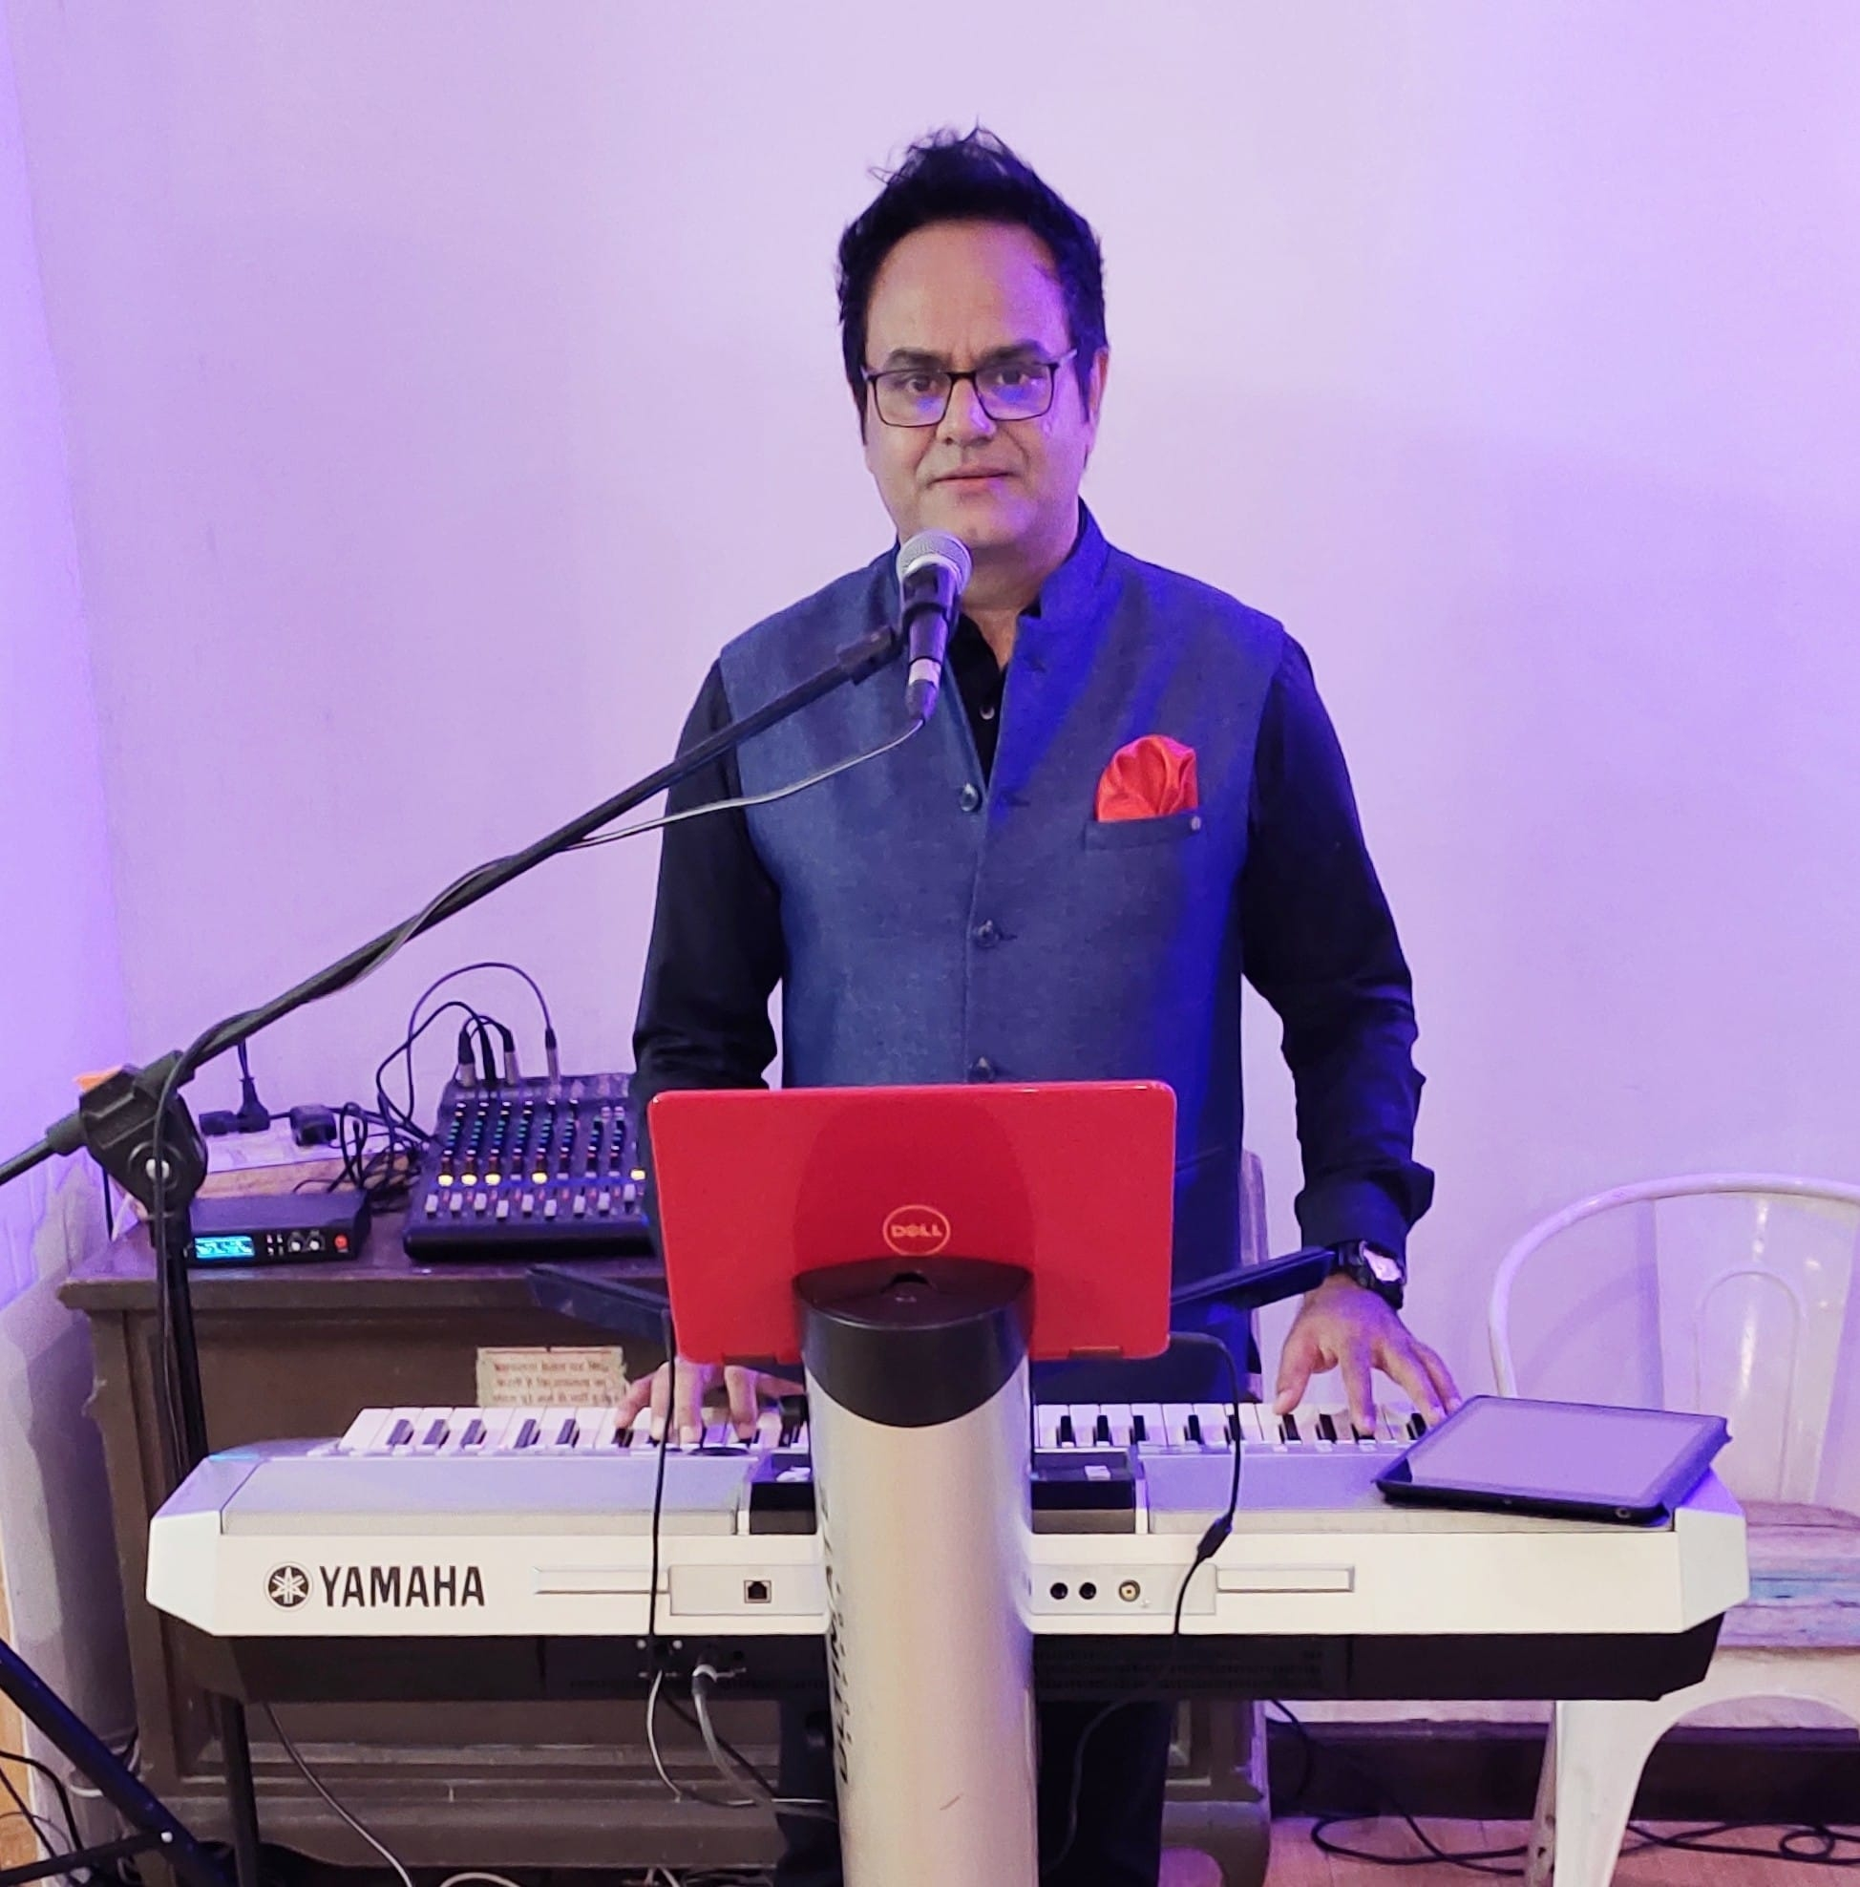

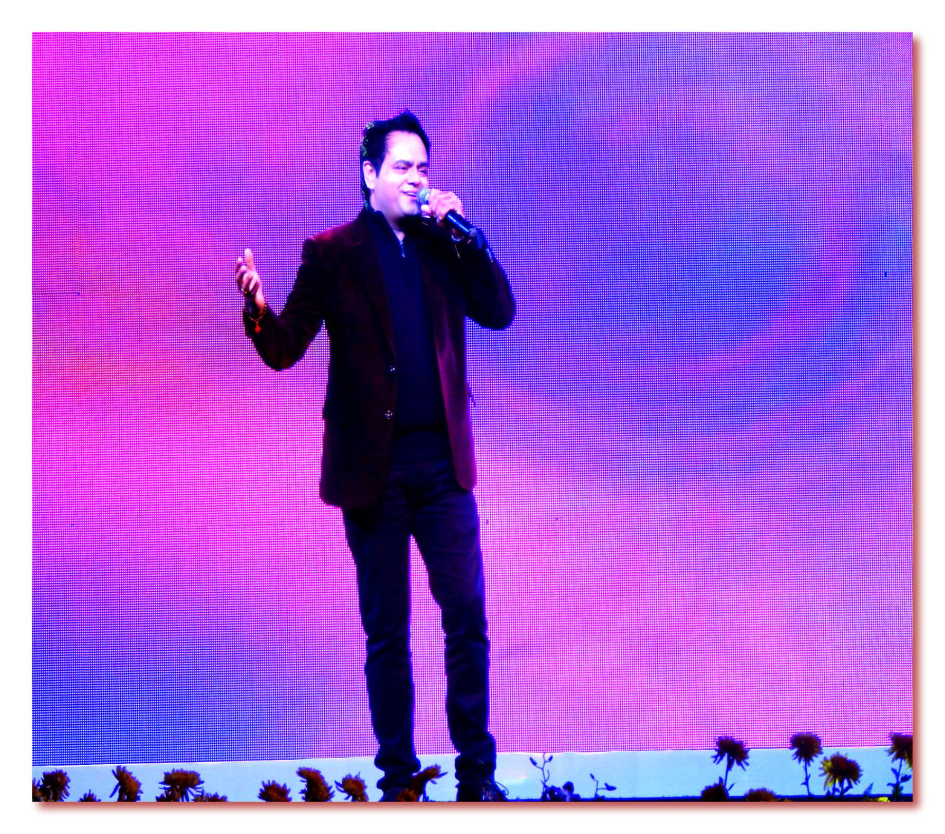



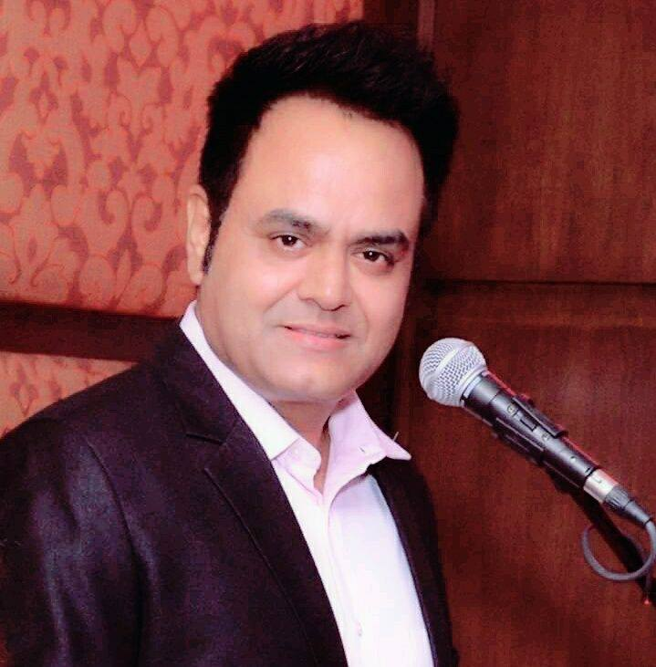


Gaurav Vats - singer
Singer Gaurav Vats have been performing since 2001, playing at festivals, listening rooms, Hotels , Delhi Gymkhana Club,
9810209534/11-25178588,
gaurav_spvats@yahoo.co.in
Link
LINK
Link1
Link 2
Link 3
Link 4
Link 5
NA

