Slide 1

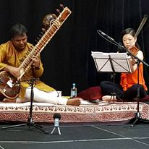





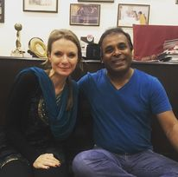



Gaurav Mazumdar- Sitar Player
Gaurav Mazumdar is a versatile composer, performer and educator who has been a champion for the preservation of classical Indian music.
9811158641/011-40553787
nmpromotions@gmail.com
Link
Link
Link1
Link 2
Link 3
link 4
Link 5
Link

