Slide 1
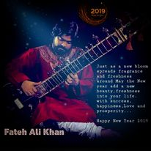
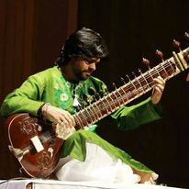
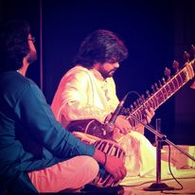



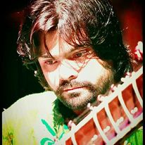
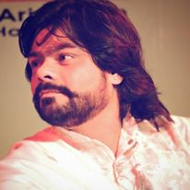



Fateh Ali- Sitar player
Fateh Ali Khan is recognised as one of the great voices in musical history.
9818124118/011-65924032
sitar.fatehali@gmail.com
Link
Link
Link1
Link 2
Link 3
link 4
Link 5
Link

