Slide 1
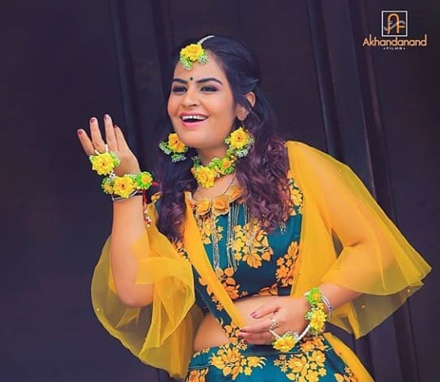
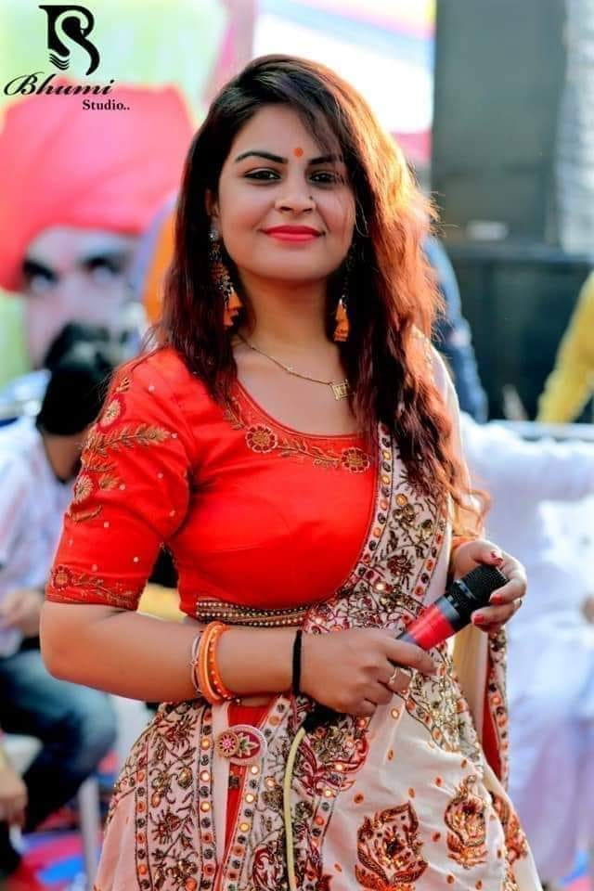
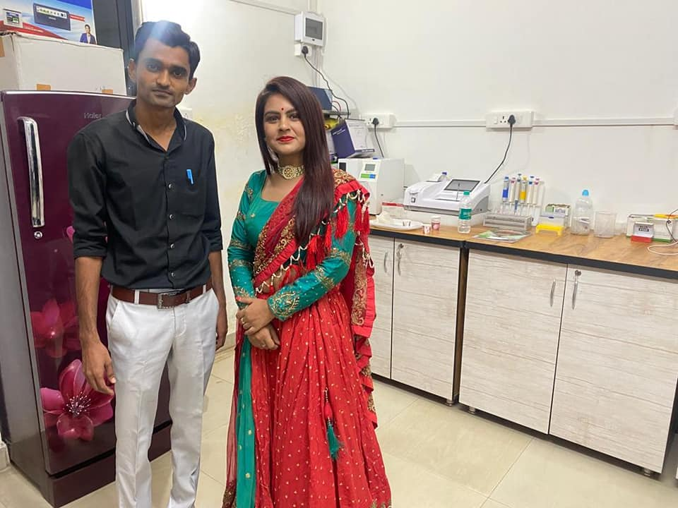



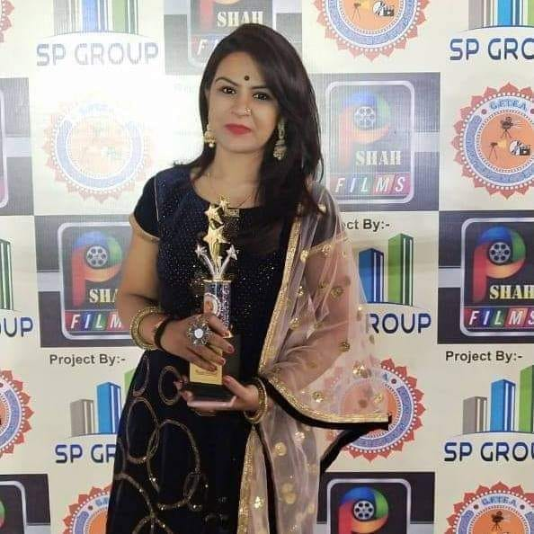
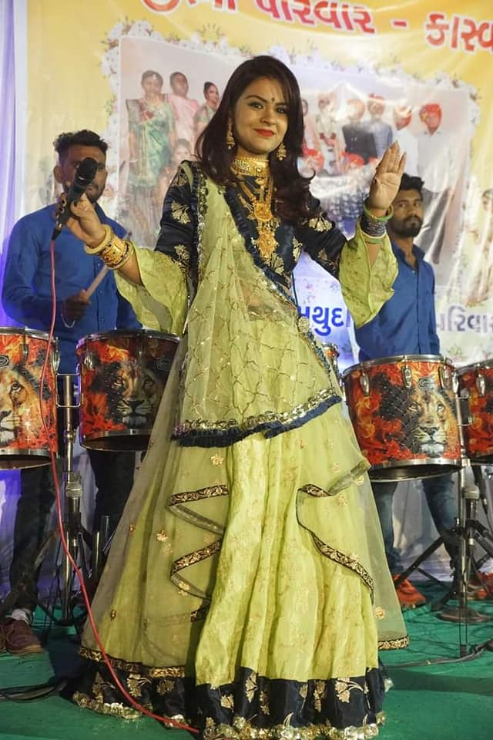



Divya Chaudhary- Rapper
Divya Chaudhary is a singer and artist with extraordinary talent. Divya Chaudhary performs in the song Afsos and is a Gujarati folk singer
9582002999
Divychaudhary7@gmail.com
Link
Link
link 4
Link 3
Link 5
Link 2
Link1
Link

