Slide 1

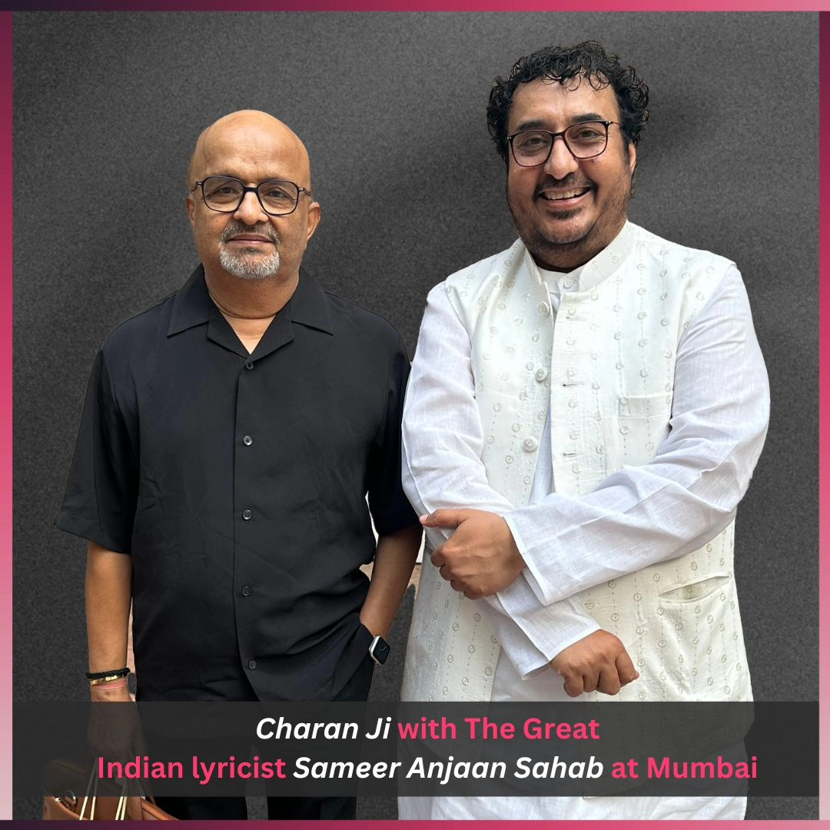
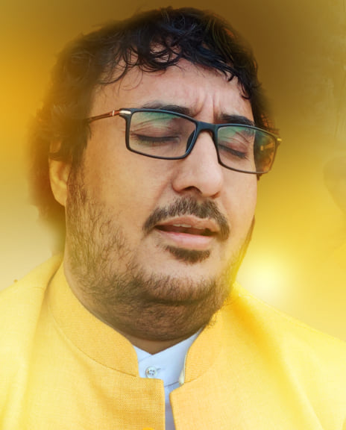




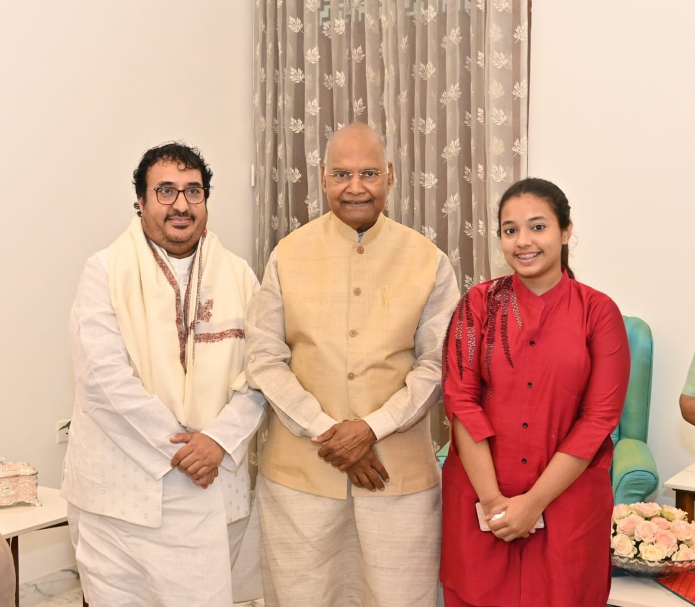
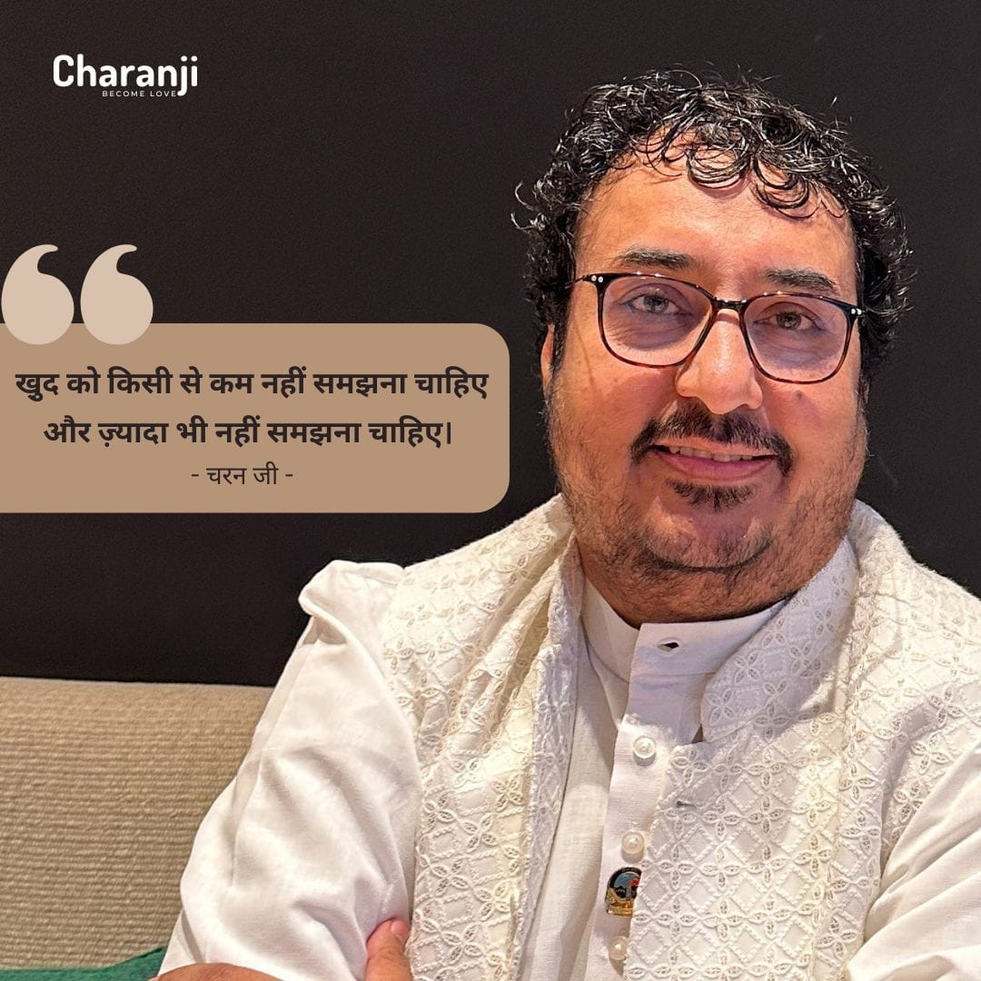



Charan ji - singer
Charanji, is a devotional bhajan singer with a heart rendering melodious voice. A specialist in sing
9810382103
NA
Link
LINK
Link1
Link 2
Link 3
Link 4
Link 5
Link

