Slide 1
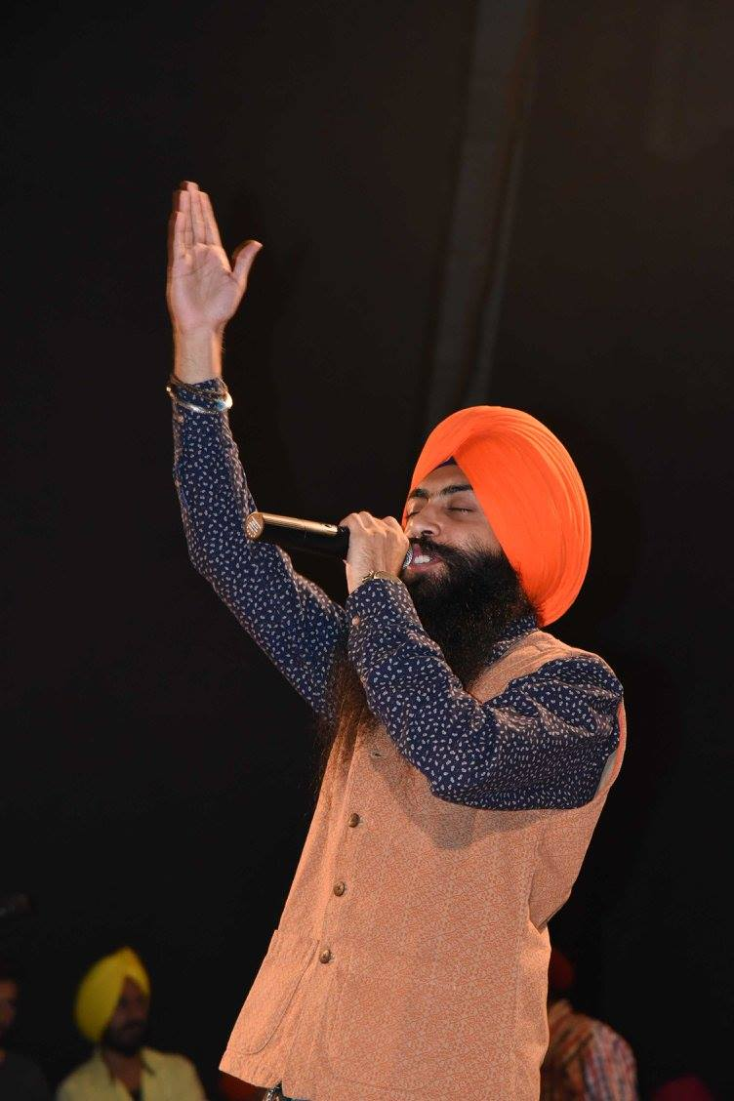
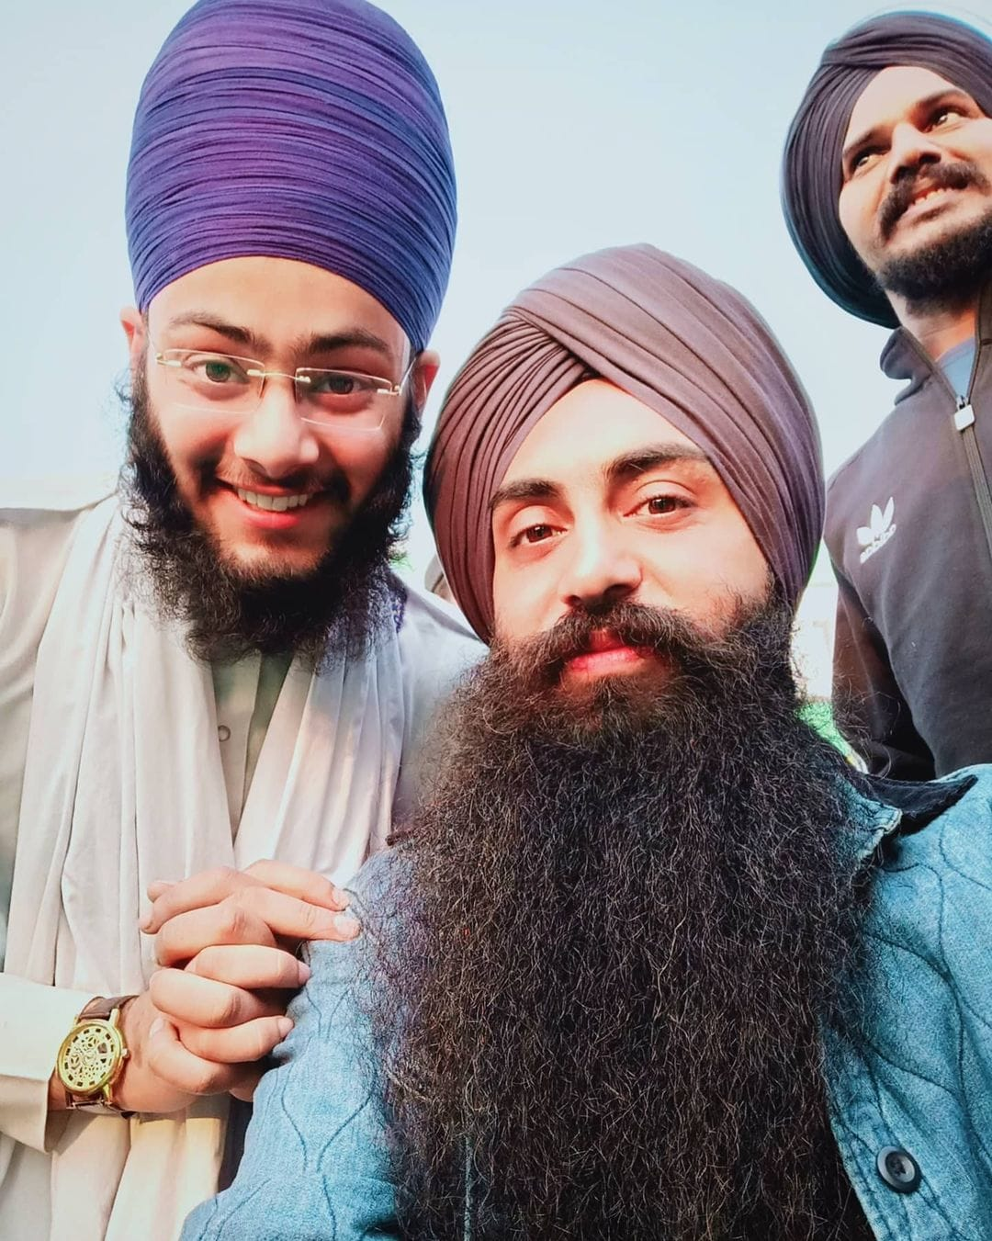
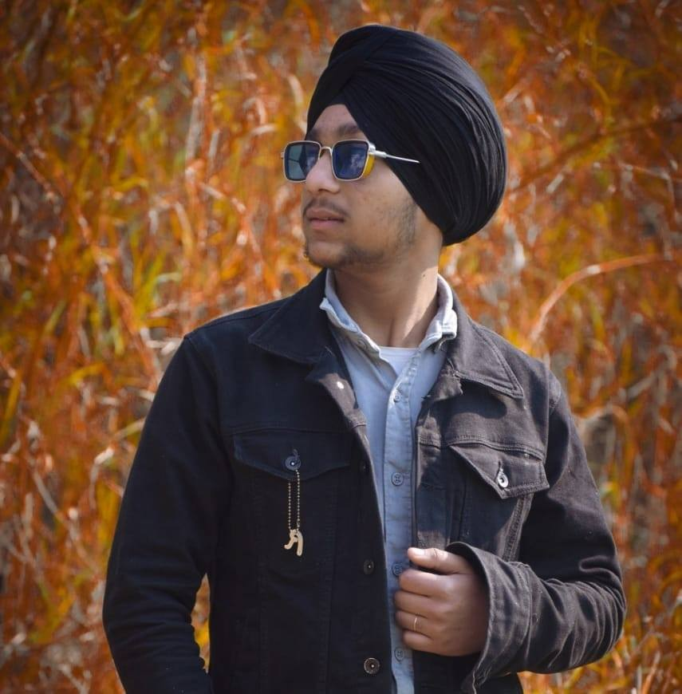



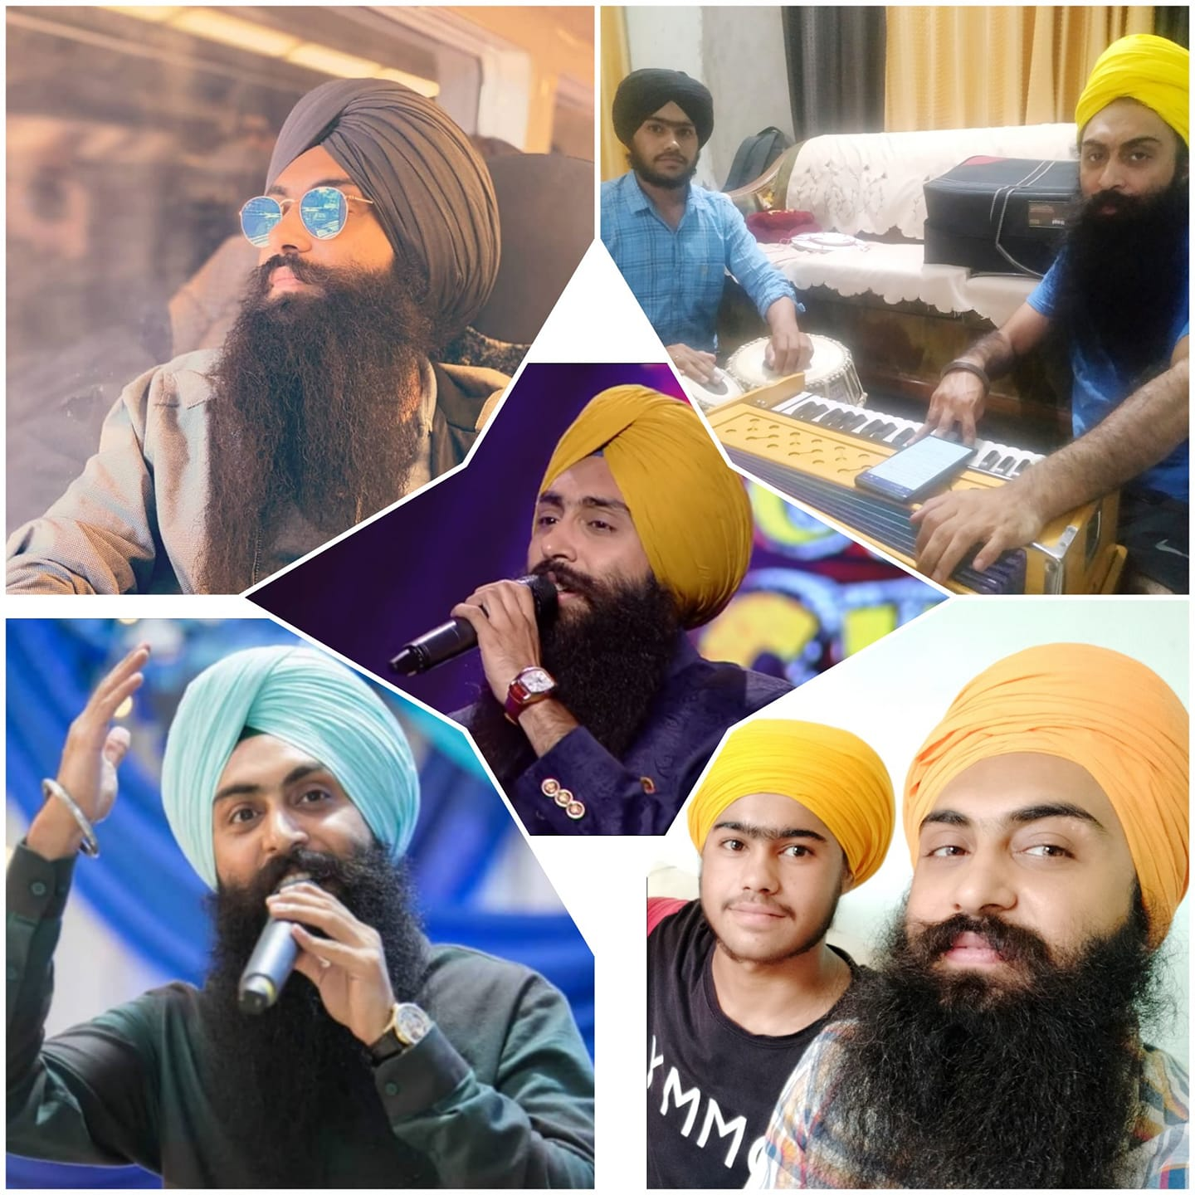

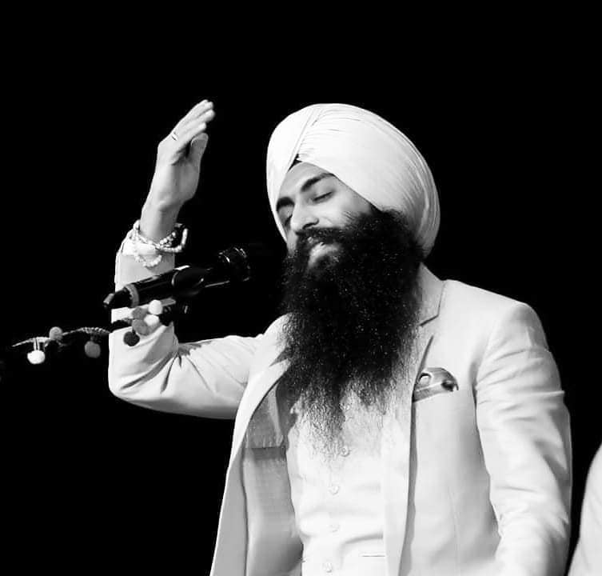


Bir Singh - Rapper
Bir Singh is a Punjabi Singer, Composer and Lyricist since 2013 and have worked with famous production houses like Rhythm Boyz Entertainment, Purple Pebble ..
8195099666/8559035054
thebleedingnibs@gmail.com /info@thebleedingnibs.com
Link
Link
link 4
Link 3
Link 5
Link 2
Link1
NA

