Slide 1
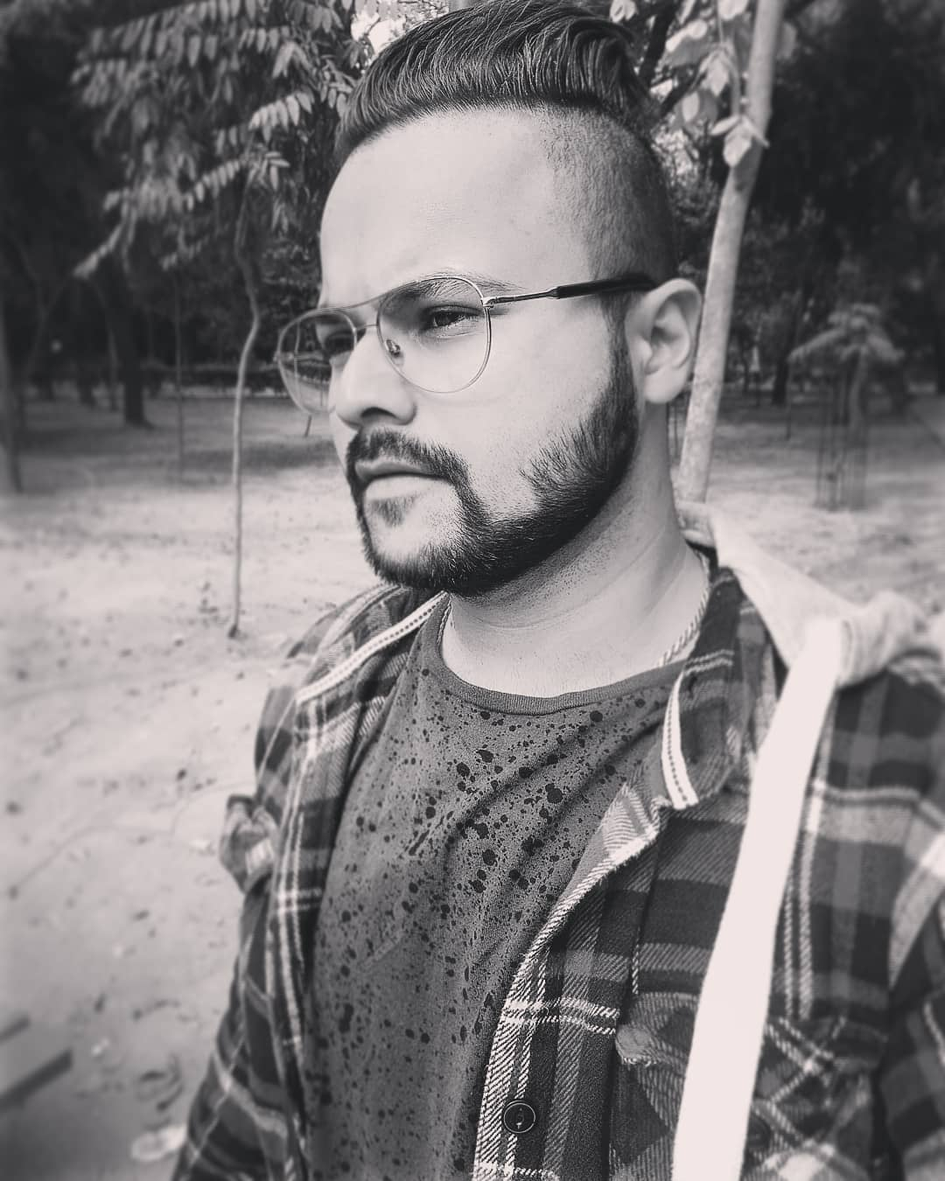
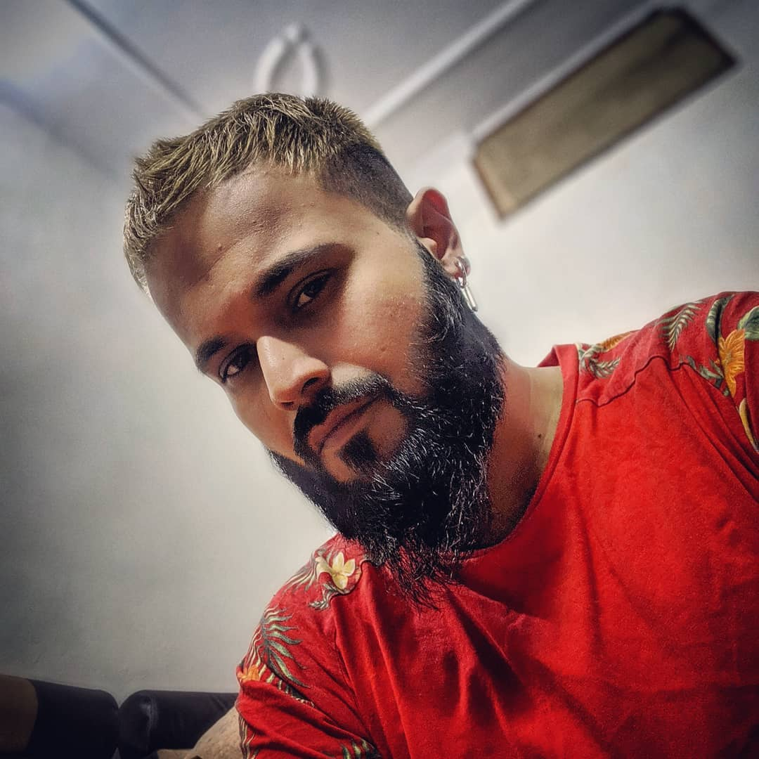
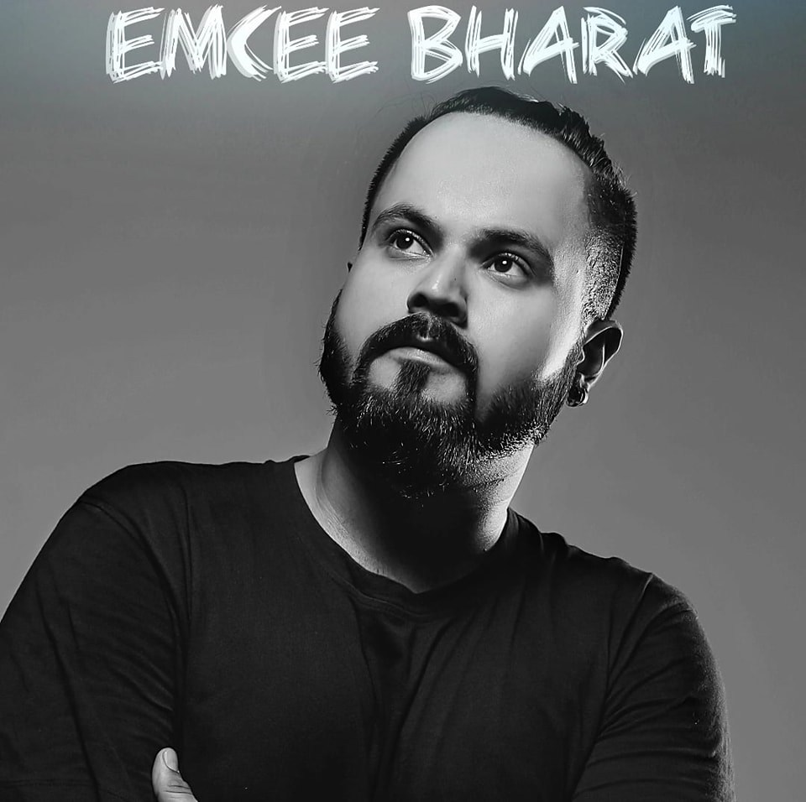


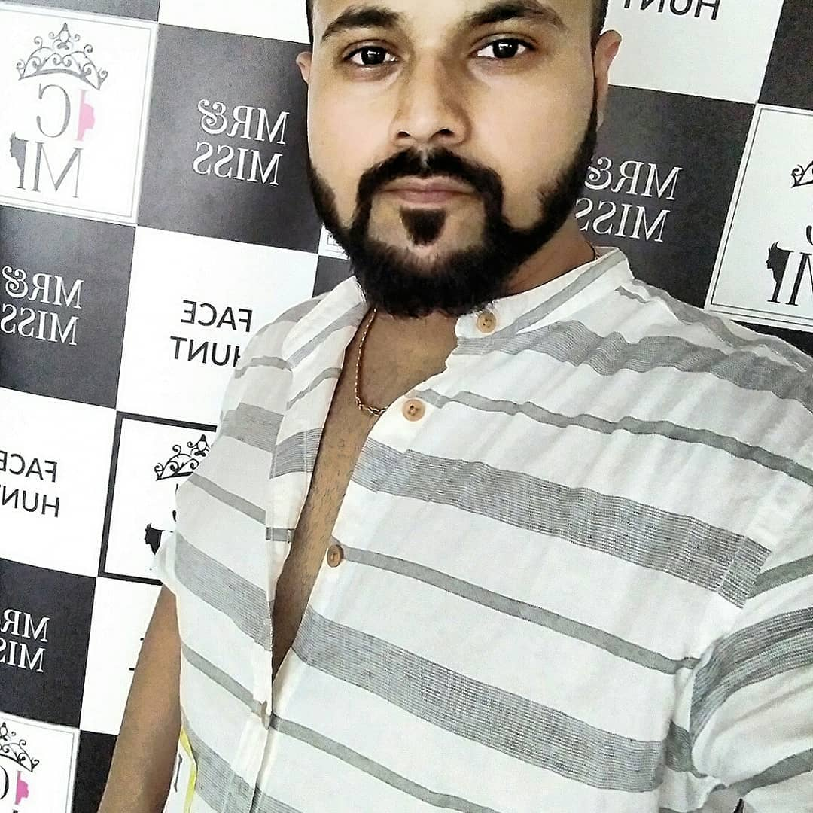

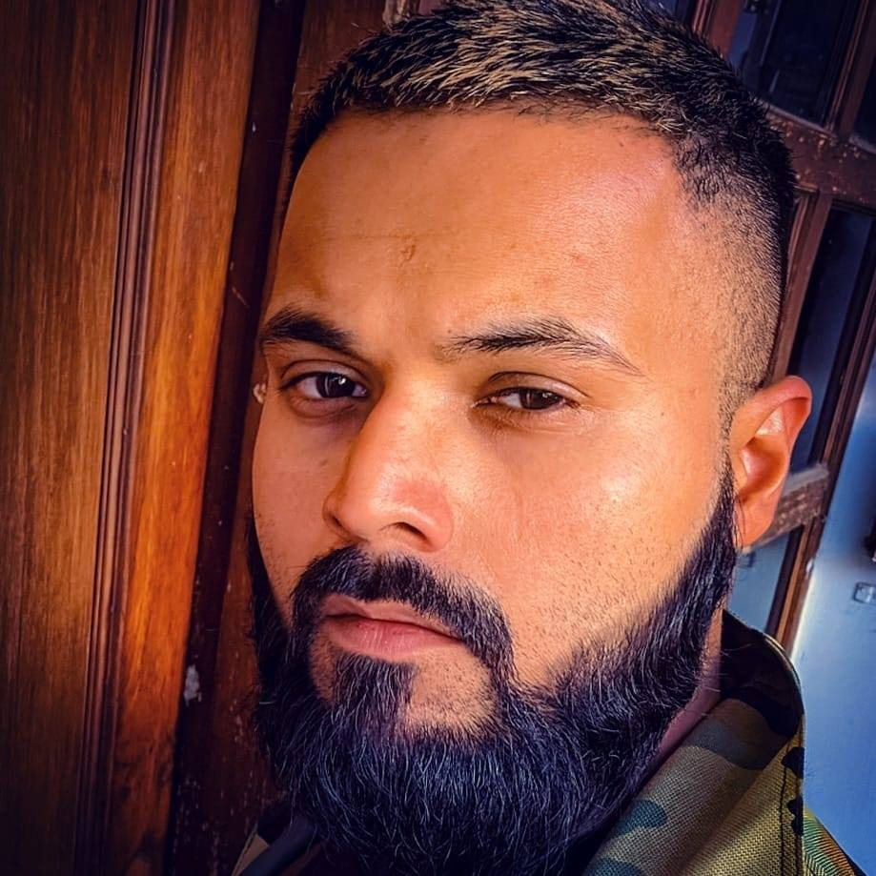



Bharat- Rapper
Bharat is a Rapper Music composer Beat production Master Video editor and Model.
9654444730/9560040156
bharatandshask@gmail.com
Link
Link
link 4
Link 3
Link 5
Link 2
Link1
NA

