Slide 1
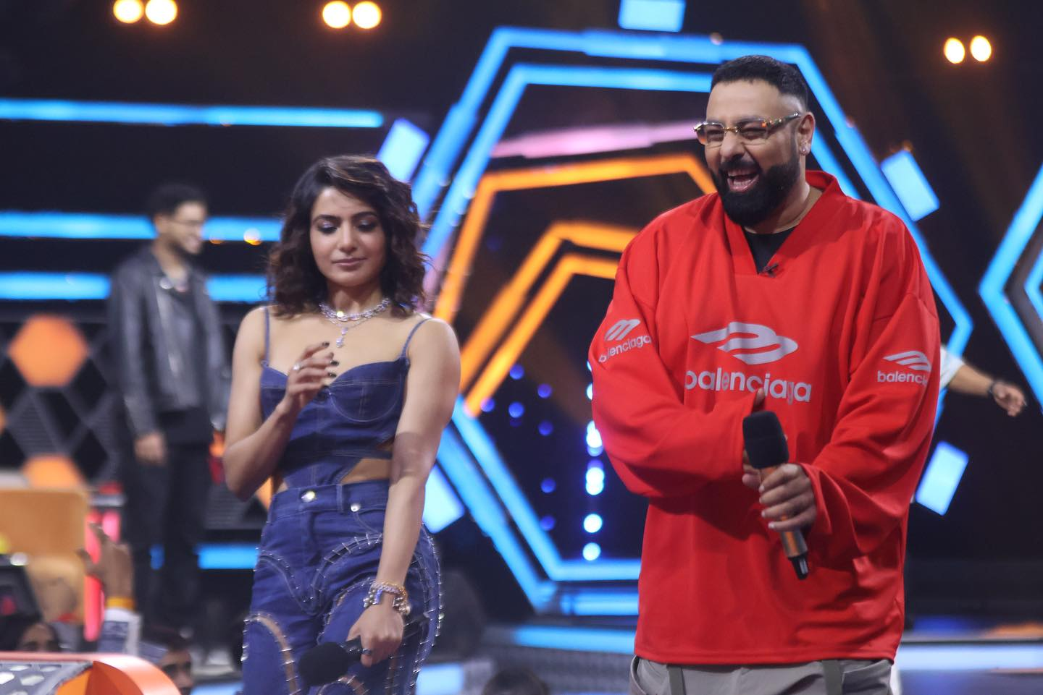
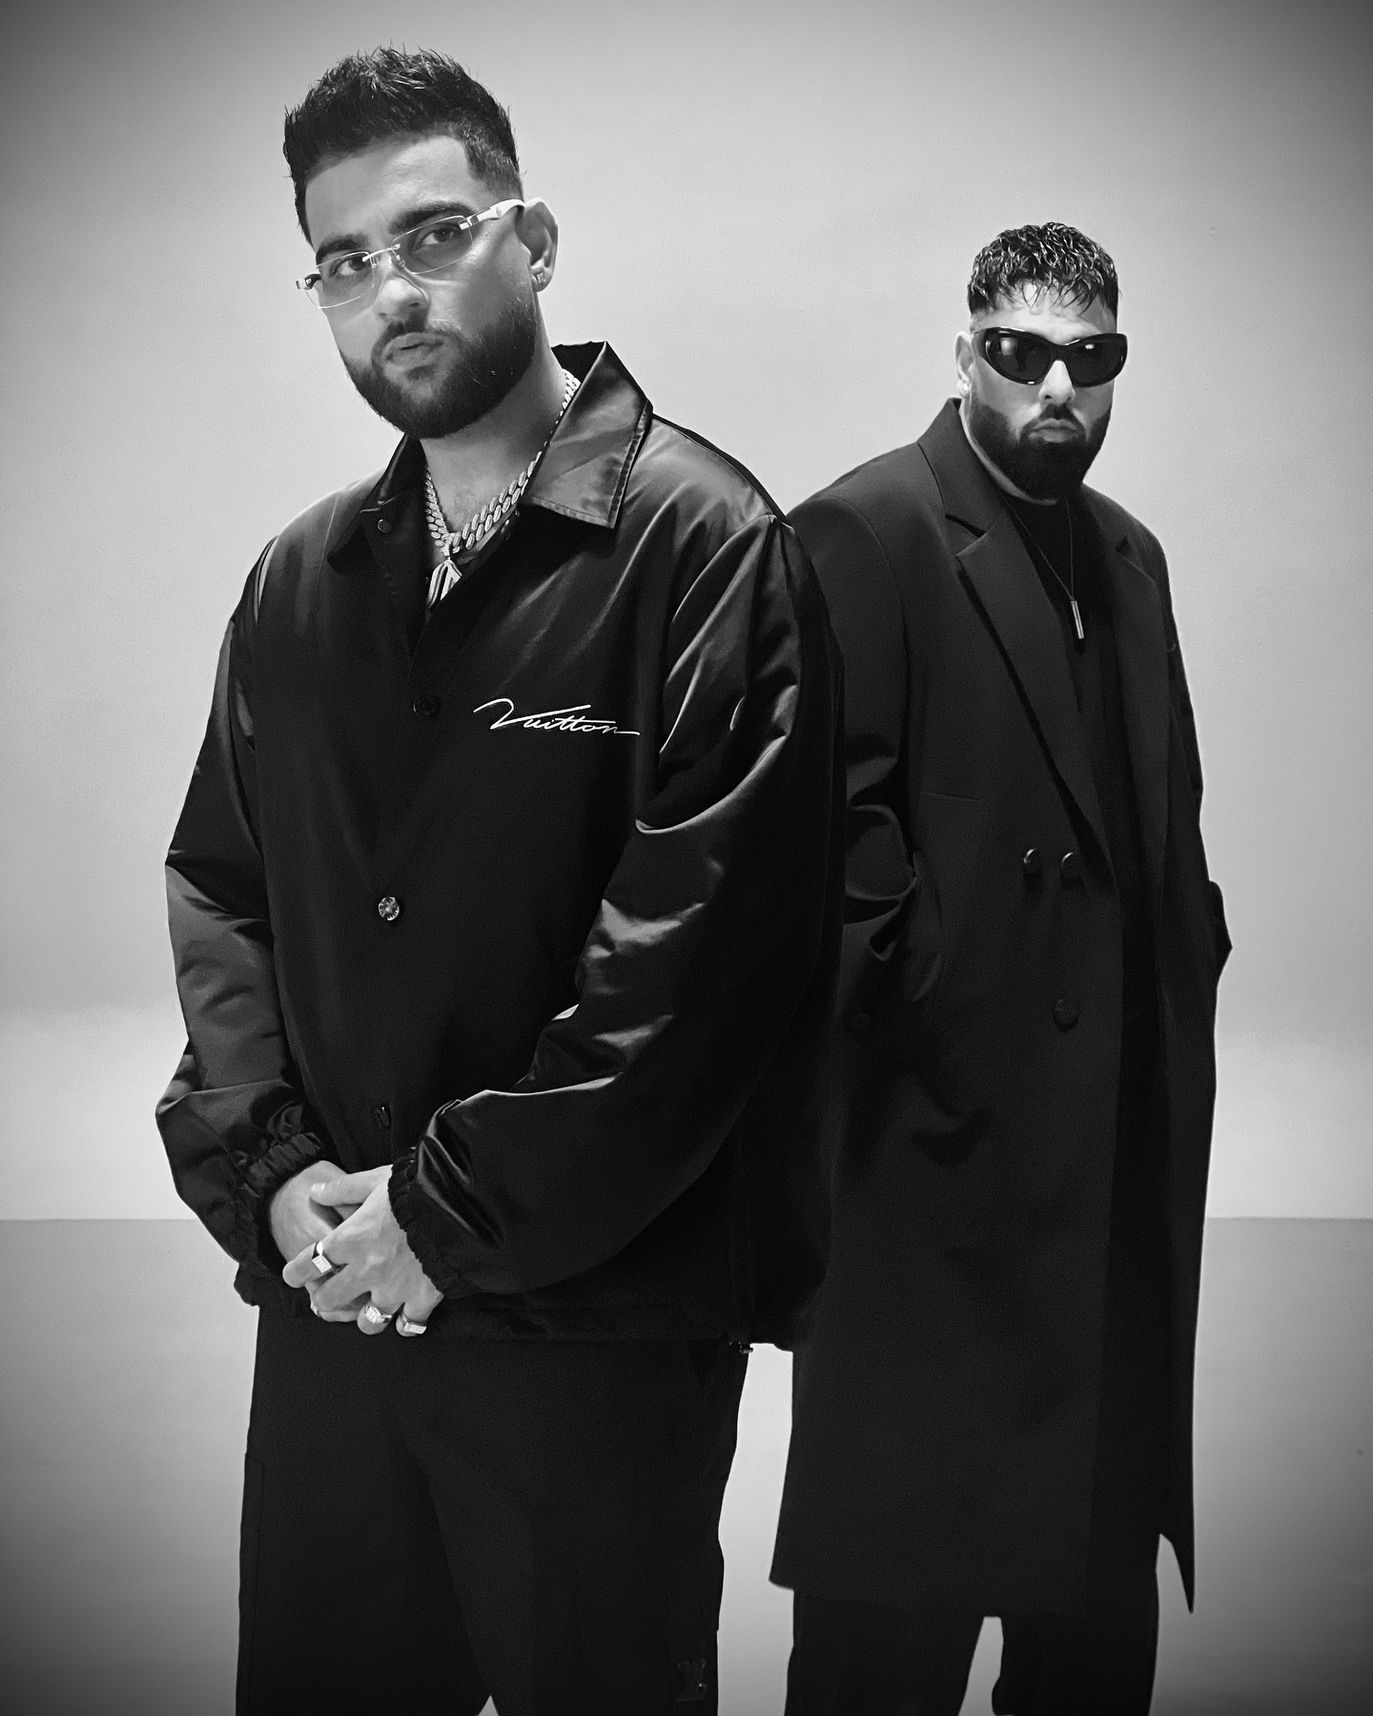
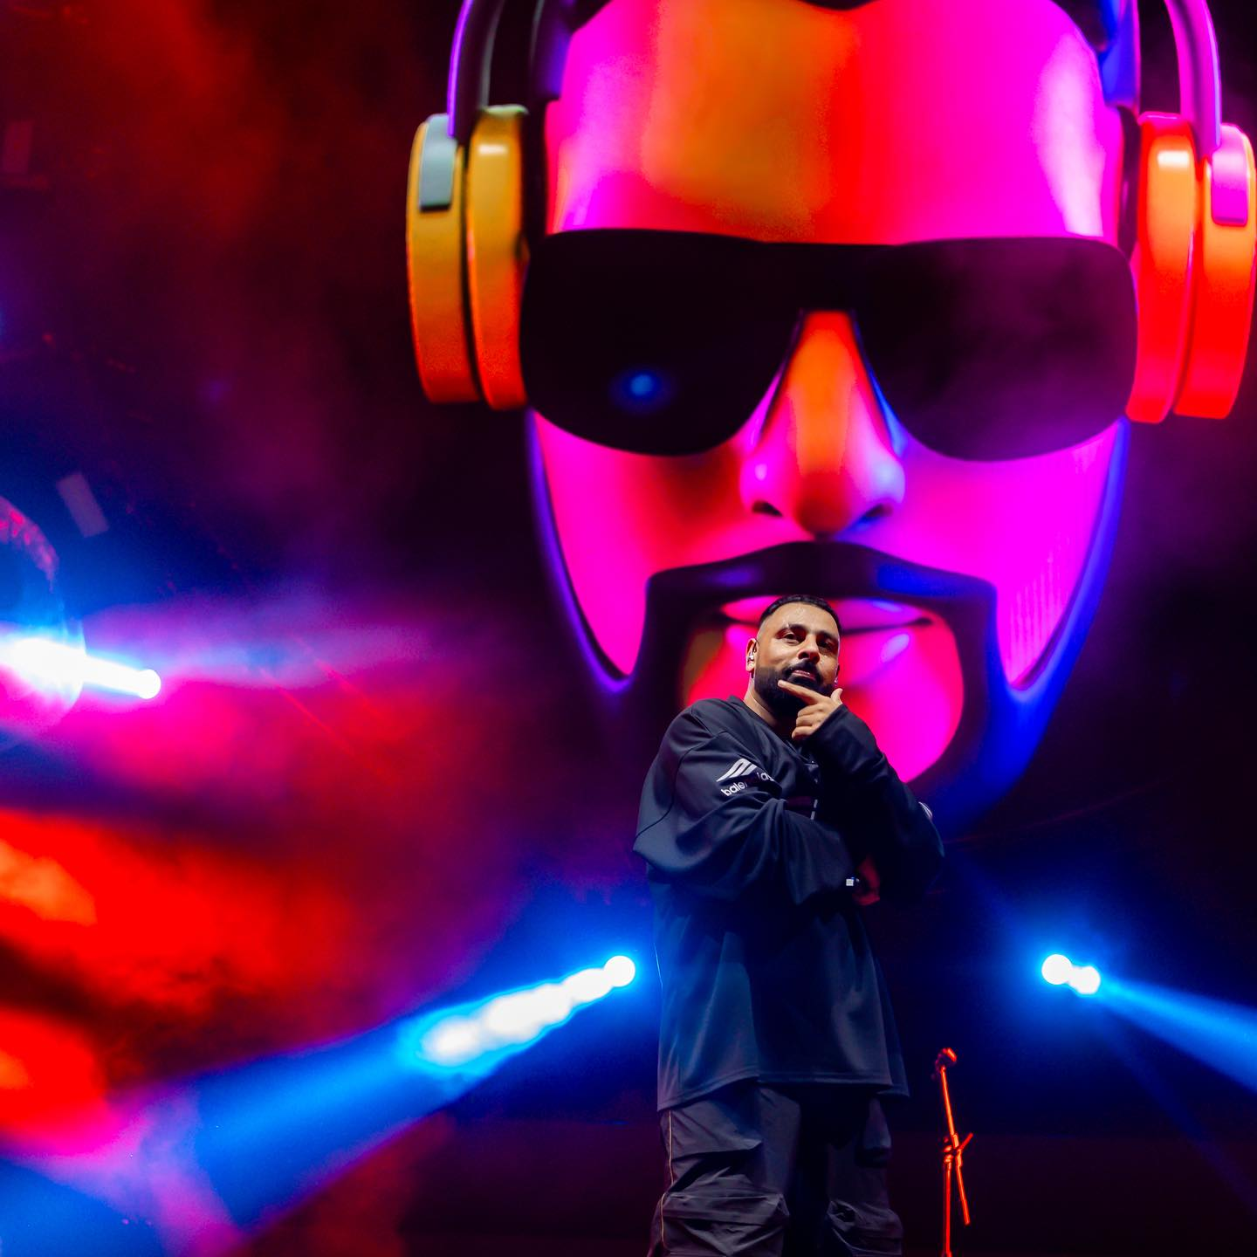

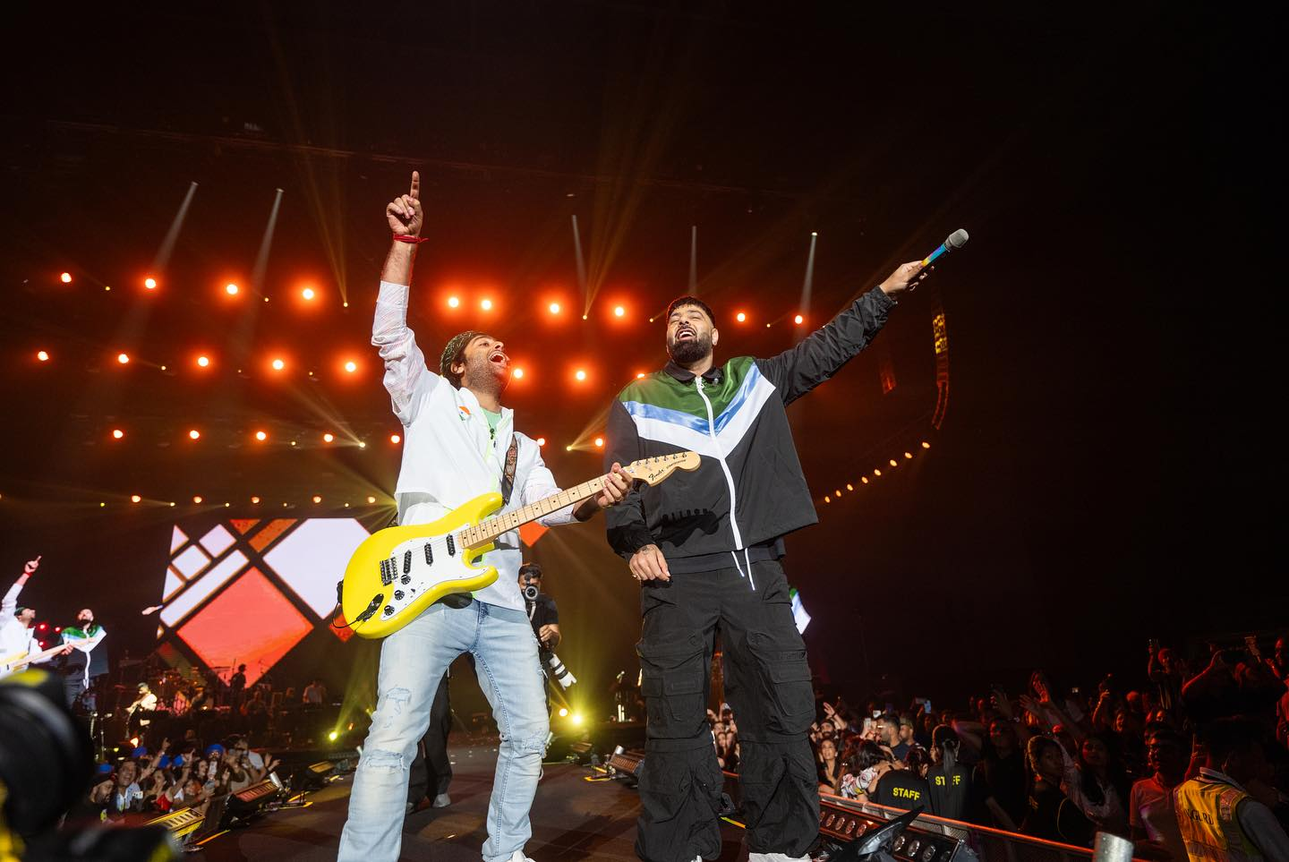


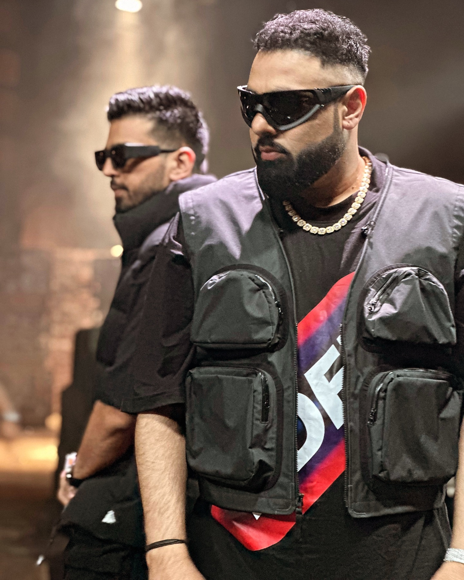



Badshah- Rapper
Aditya Prateek Singh Sisodia, known professionally as Badshah, is an Indian rapper, singer, songwriter, and producer
9582476222
NA
Link
LINK
link 4
Link 3
Link 5
Link 2
Link1
NA

