Slide 1






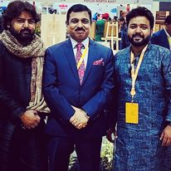
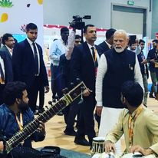
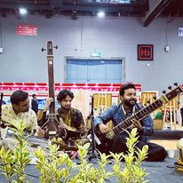



Azeem Ahmed- Sitar player
Azeem Ahmed he has been awarded the National Scholarship by Government of India and has performed at numerous prestigious music festivals in India.
9871872257
sitarproject@gmail.com
Link
Link
Link1
Link 2
Link 3
link 4
Link 5
Link

