Slide 1



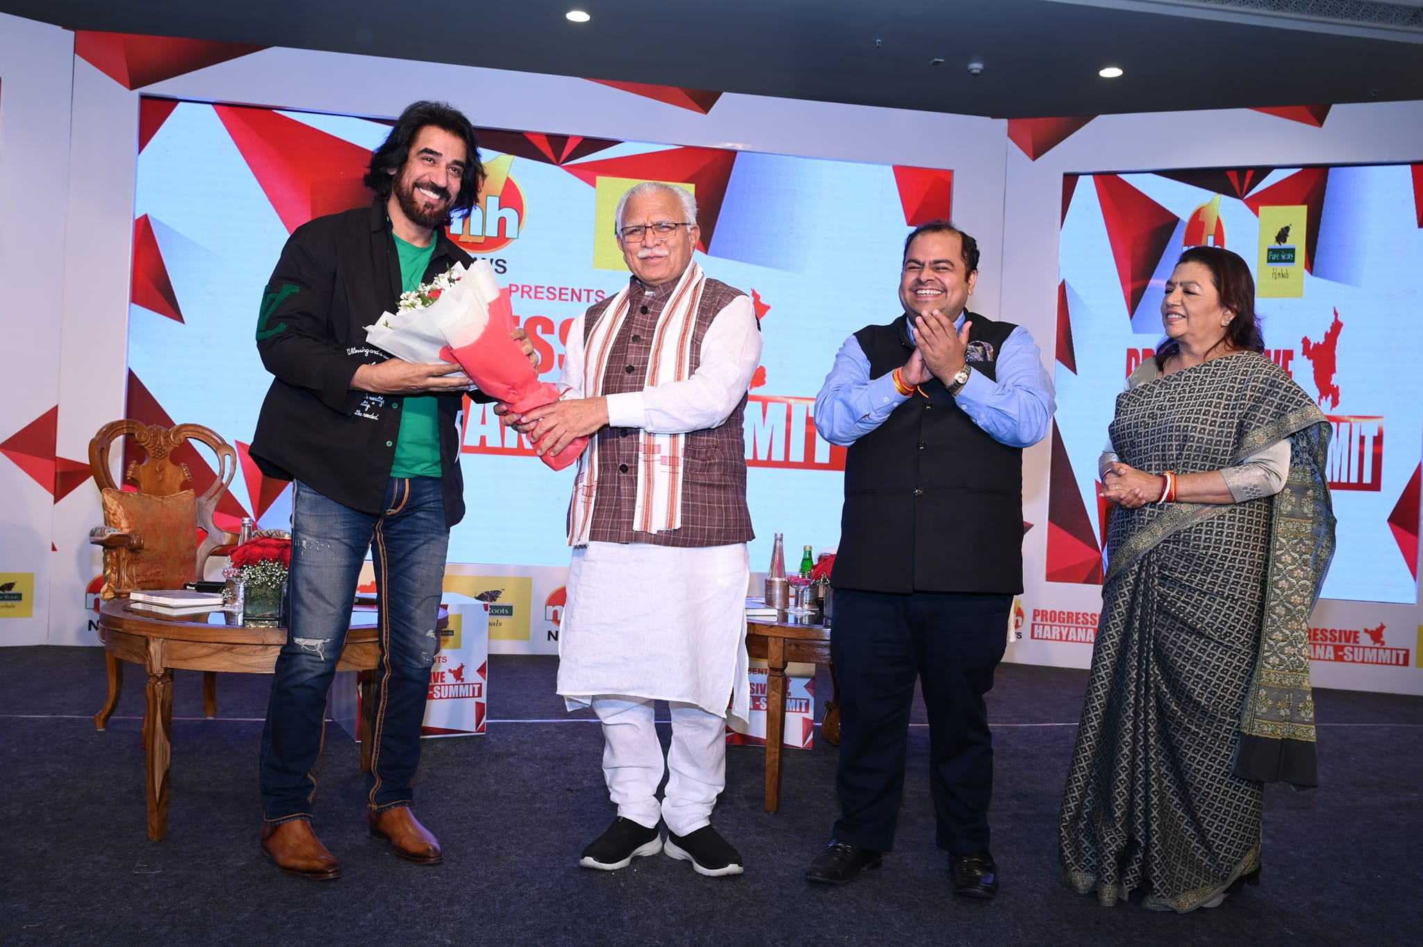







Ashok Masti -Playback singer
Ashok Masti is an Indian Playback singer. He is best known for his song "Khadke Glassy" which is sung by him and Yo Yo Honey Singh from the movie Jabriya Jodi starring Parineeti Chopra
9810154788/11-46170226
ashokmasti@ymail.com
Link
LINK
Link1
Link 2
Link 3
Link 4
Link 5
Link

