Slide 1
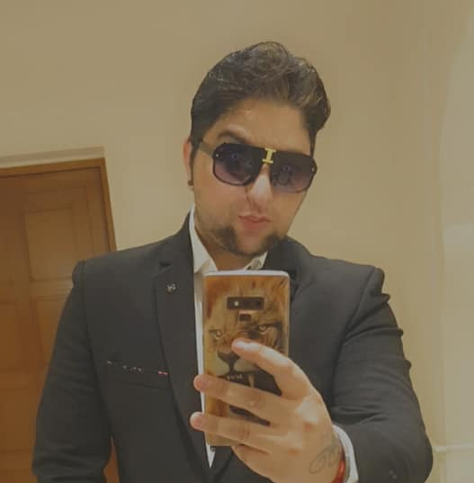
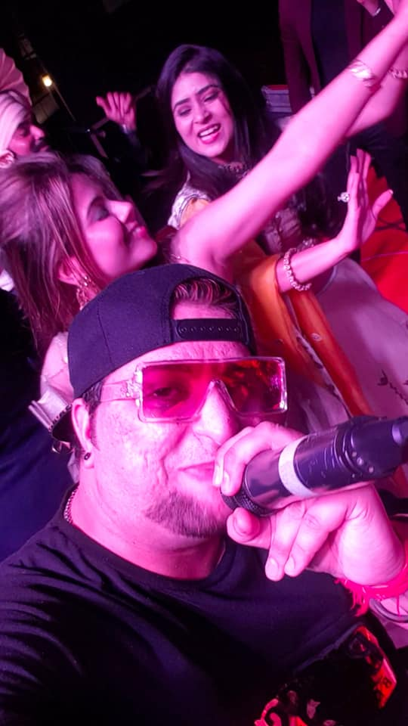
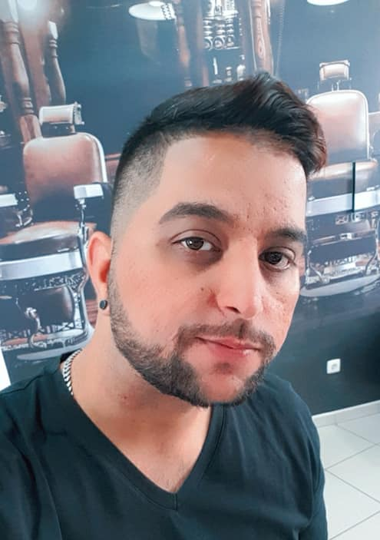



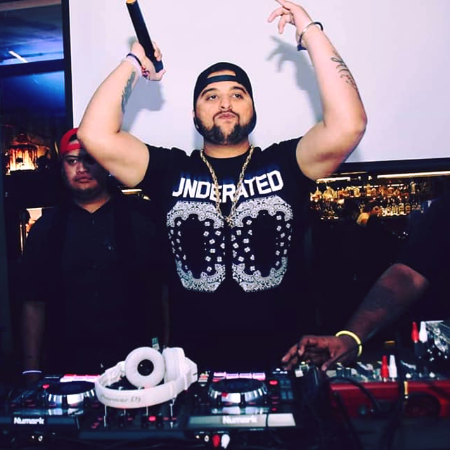





Ansh Kapila- Rapper
“Rapper Ansh" aka Dilli Da Dilwala . As the name suggests, a man gifted with many talents, warm presence and positive attitude. Widely recognized as a complete entertainment factory.
9999162013
ankit.kapila3@gmail.com
Link
Link
link 4
Link 3
Link 5
Link 2
Link1
NA

