Slide 1
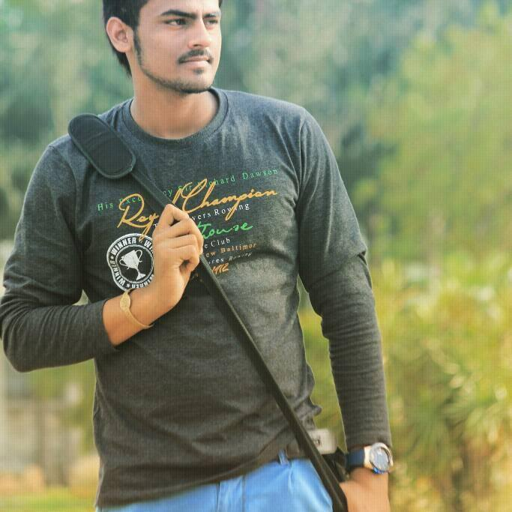
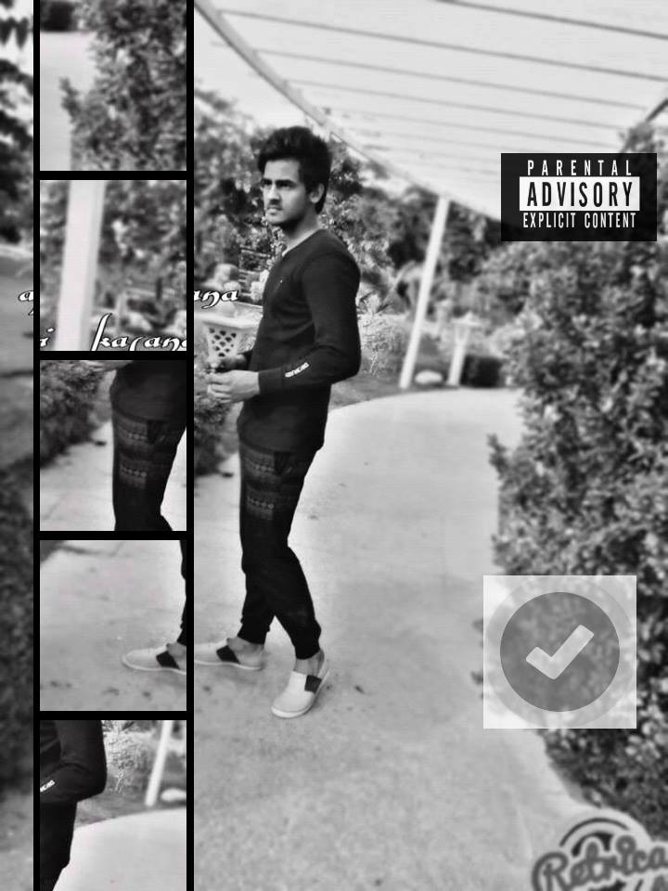
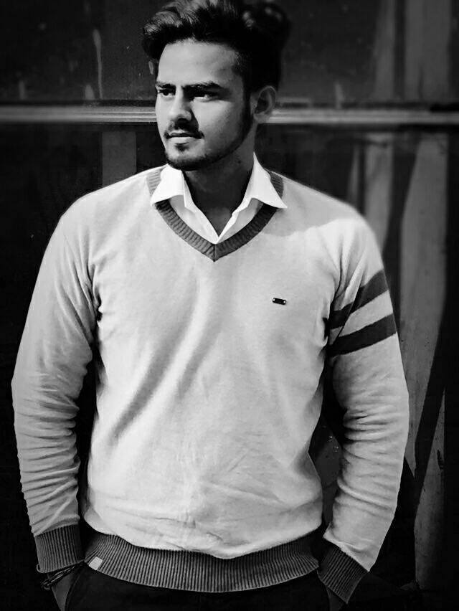


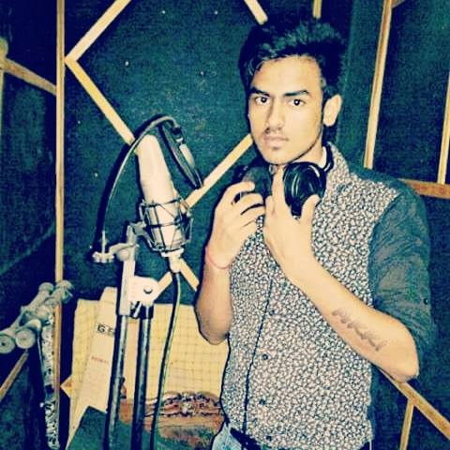


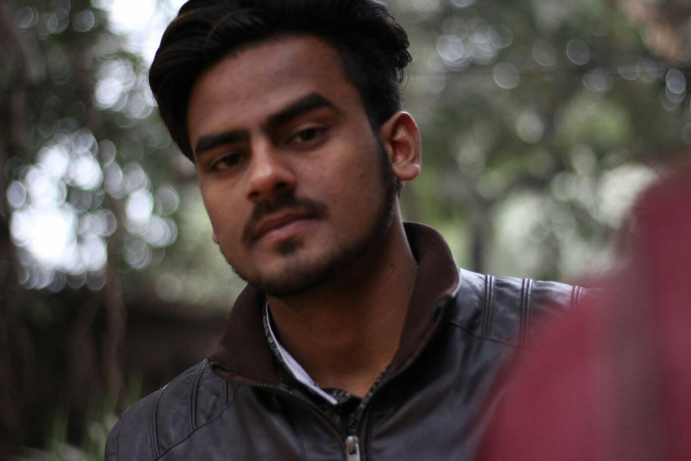


Akki Kasana- Rapper
akki kasana-aka rapper. Vocalist for rapper akki kasana. Greater Noida, IN. Interested In. About; Projects; Past Gigs; Gear.
9540414500
NA
Link
NA
NA
Link 3
NA
Link 2
Link1
NA

