Slide 1
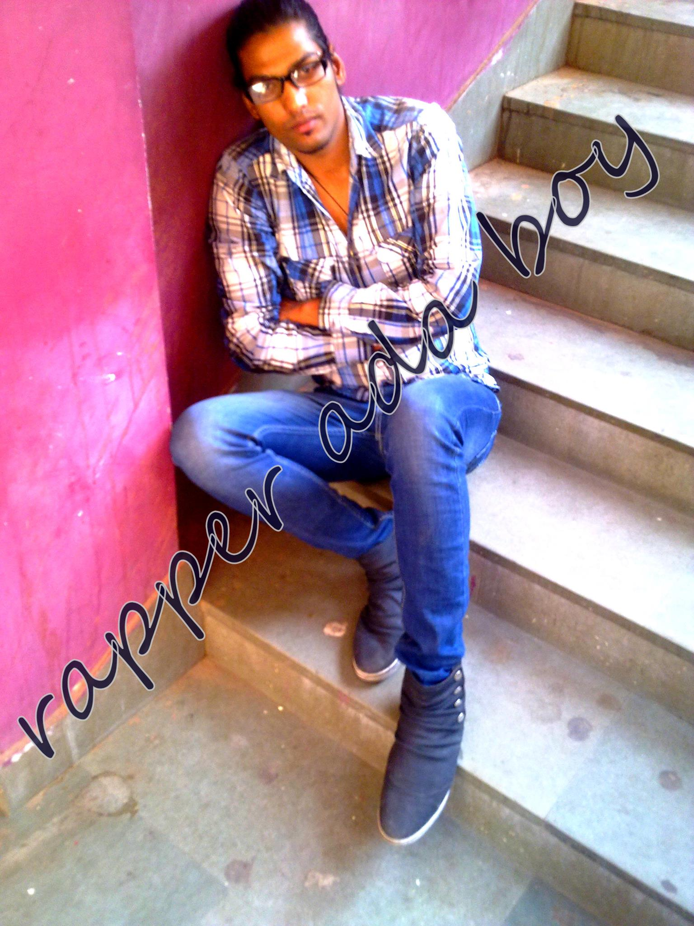

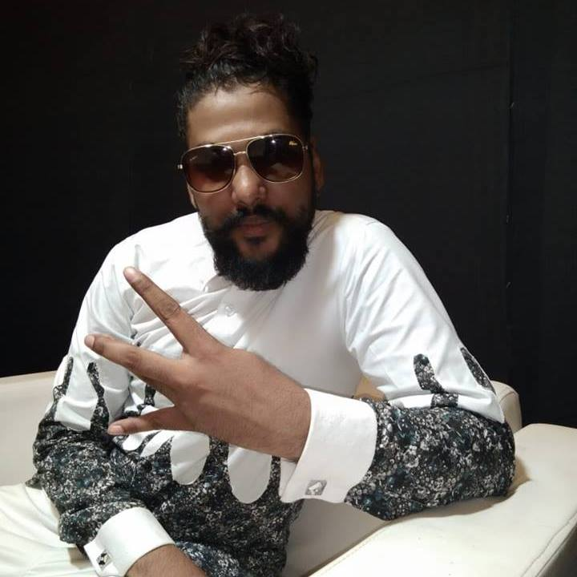

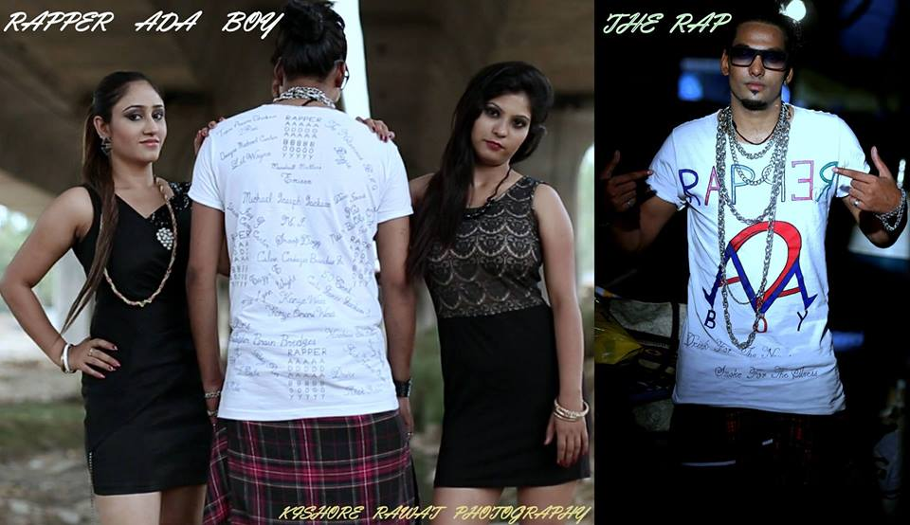

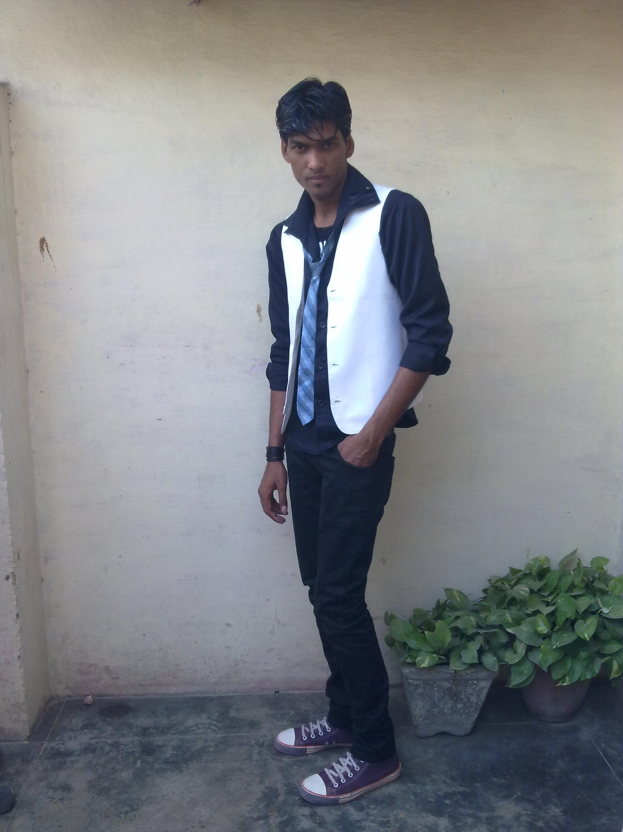



Ada Boy- Rapper
RAPPER ADA BOY- is the real name of this young RAP artist"ANURAG SHARMA" . he took interest in rap , hip hop , pop & metals music at young age of 15
9907347560/09582512720
rapperadaboy@yahoo.com
Link
LINK
link 4
Link 3
Link 5
Link 2
Link1
Link

